Slide 1



STOP THE BLEED® Course
American College of Surgeons
SAVE A LIFE
Copyright © 2019 American College of Surgeons
Version 2
BLEEDINGCONTROL.ORG
STOPTHEBLEED.ORG
STOP THE BLEED® is a registered trademark of the U.S. Department of Defense
Notes:
Note to instructor: This presentation includes the slide set you will need in order to deliver the didactic portion of the Stop the Bleed Basic course as well as instructor notes to assist you with the delivery of this material.
Consider downloading and printing these slides as a handout for course participants.

Slide 2
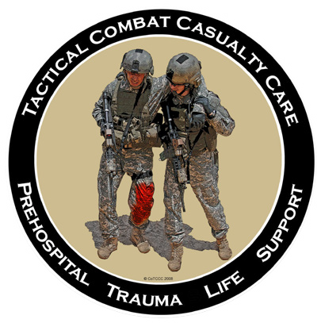




The American
College of Surgeons Committee on Trauma
The American
College of Emergency Physicians
The National Association of
Emergency Medical Technicians
The Committee on Tactical Combat Casualty Care
Notes:
This educational program represents the joint effort of many organizations.
It represents the current “best practice” recommendations for how to manage life-threatening bleeding.
Stop the Bleed®

Slide 3
Some of the images shown during this presentation may be disturbing to some people.
Notes:
This course was designed to teach you how to recognize and control life-threatening hemorrhage and respond to a deadly injury. We cannot do that without clinical photographs that are relevant to the course content. Some of these photographs are graphic in nature and may be disturbing to some individuals.
The lay-public course does not have graphic clinical photos, but this slide allows you to speak to bleeding emergencies can be graphic and the immediate responder will see a lot of blood. Managing their expectations regarding a bleeding emergency can be discussed.

Slide 4
Why Do I Need This Training?
The #1 cause of preventable death
after injury is bleeding.
Notes:
Ask class why they are taking the course.
Bleeding is the most common cause of preventable death after injury and must be stopped as soon as possible.

Slide 5




Where Can I Use This Training?
Notes:
Ask class, where might these new skills be called upon.
Many injury mechanisms can result in serious bleeding.
Stress that while mass shootings currently receives a lot of attention, serious bleeding is more likely to result from everyday injuries such as those that may occur at home, at work or while on the road.
The techniques being taught in this course apply to bleeding regardless of the cause.
Consider using one or two examples where they may encounter life-threatening bleeding such as during a sporting event or around broken glass at home.

Slide 6
Goals
1. Identify
Recognize
life-threatening bleeding
Stop the Bleed
Take steps to
STOP THE BLEEDING
  Pressure
✓ Packing
✓ Tourniquets
Notes:
The focus of this program is the immediate response to bleeding.
Everyone should know how to recognize life-threatening bleeding.
Everyone should be able to take the appropriate steps to control bleeding until help arrives.
If you do not feel comfortable with controlling bleeding, you can still help by calling 911 and assisting others who are controlling bleeding.

Slide 7
Personal Safety
YOUR safety is YOUR first priority
If you are injured, you cannot help others
Help others only when it’s safe to do so
If the situation changes or becomes unsafe:
✓ Stop
✓ Move to safety
✓ If you can, take the victim with you
Notes:
Your personal safety is an important consideration. If you become injured as well, you won’t be able to help anyone and you will become a victim, the situation you find yourself in becomes more complicated. If the scene in not safe for whatever reason, you should remove yourself (and the victim, if possible) from danger and try to find a safe location. Once you reach safety, you can focus on bleeding control.

Slide 8
Personal Safety
YOUR safety is YOUR first priority
Wear gloves if you can
If you get blood on you, be sure to clean any part of your body that the blood has touched
Tell a health care provider that you got blood on you, and follow his or her direction
Notes:
Stress the importance of personal protective equipment and avoiding contact with blood and body fluids.
While the risk of transmission is extremely low, it is not zero.
Avoid direct contact with blood or body fluids on your skin, eyes, or mouth
Wear gloves whenever possible
Wash hands after any contact even if no visible blood

Slide 9
ABCs of Bleeding Control
A Alert 911
B Bleeding
C Compress

Slide 10
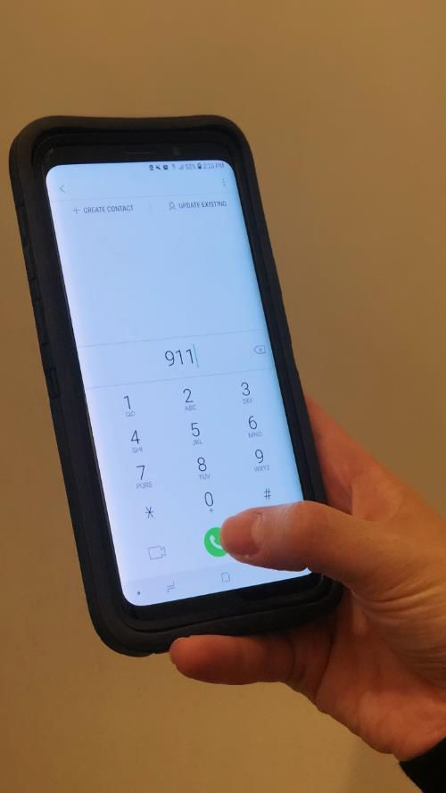
ABCs of Bleeding Control
A Alert 911
B Bleeding
C Compress

Slide 11
ABCs of Bleeding Control
A Alert 911
Call 911
Know your location
Follow instructions provided by 911 operator
Notes:
The 911 dispatcher will guide you through the conversation. What happened?
When did it occur?
Where are you?
Number and status of victims?
Ongoing threats to your safety?
Note* (Can be explained to the participant if necessary) When you make a 911 call on a mobile phone, you are sending signals through the air. The tower that picks up your phone's signal may be near or not. That's not enough information for the dispatcher to find you.
You must know your location and if you are using a cell phone, the call back number.
If the situation and your battery power allows, you, or someone, should stay on the line.

Slide 12
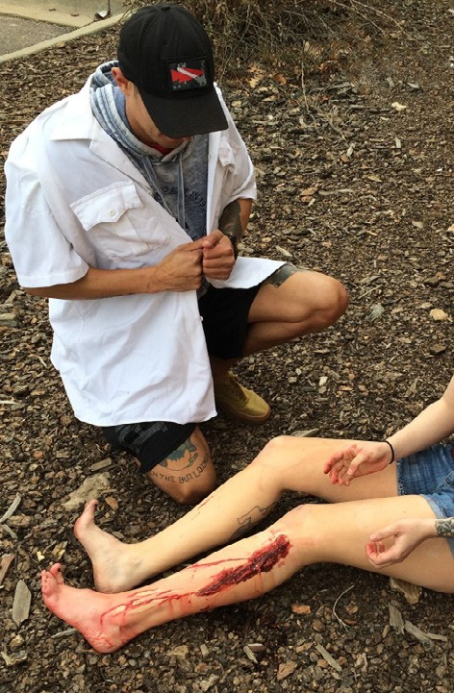
ABCs of Bleeding Control
A Alert 911
B Bleeding
C Compress

Slide 13
ABCs of Bleeding Control
B Bleeding
Find source of bleeding
Look for:
  Continuous bleeding
  Large-volume bleeding
  Pooling of blood
Notes:
Life threatening bleeding is large volume bleeding that is continuous, large volume, pulsatile, like a sprinkler, or is enough to pool in clothing or on the ground. The faster we can control the bleeding the better the patient will do.

Slide 14
ABCs of Bleeding Control
B Bleeding
There may be multiple places the victim is bleeding
Clothing may also hide
life-threatening bleeding
Notes:
Even if you find one source of bleeding, there may be others.

Slide 15
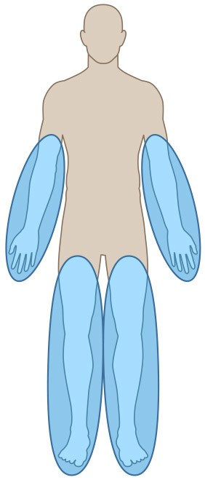
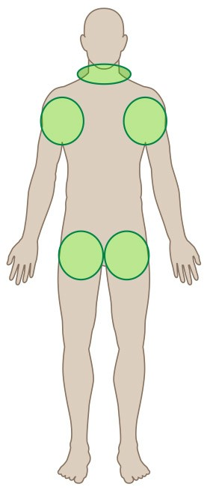
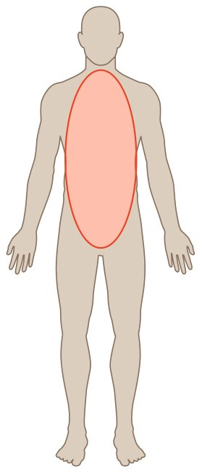
ABCs of Bleeding Control
B Bleeding
Arms and legs
Neck, armpits,
and groin
Body
Notes:
“The principles being taught in this course apply to external bleeding. This can occur from the extremities (blue) and from the junctional areas (green) which consist of the neck, armpits and groin. Junctional bleeding can be severe as large caliber blood vessels run through these areas. The third location where there can be bleeding is the body (red). This internal bleeding into the body cannot be controlled in the field and requires rapid transportation to a trauma center.”

Slide 16
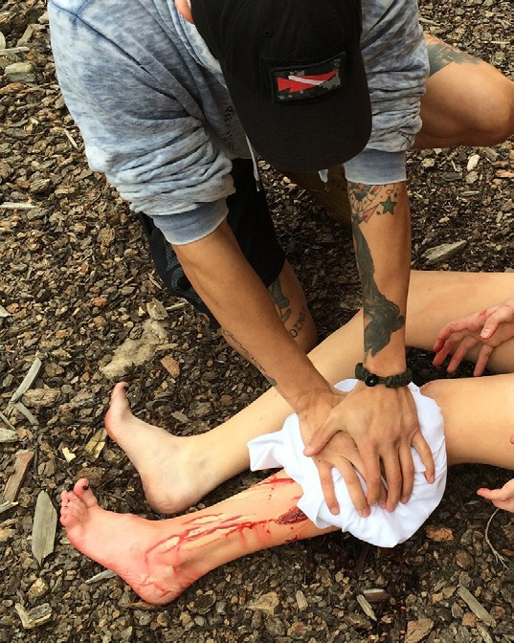
ABCs of Bleeding Control
A Alert 911 B Bleeding
C Compress - Pressure

Slide 17
ABCs of Bleeding Control
C Compress - Pressure
Apply direct pressure to wound
Focus on the location of the bleeding
Use just enough gauze or cloth to cover injury
If pressure stops the bleeding, keep pressure on wound until help arrives
Notes:
Pressure will stop the majority of bleeding.
Start with pressure, use a small amount of gauze or material, just enough to cover the wound. Excess gauze or material makes pressure ineffective. If gauze is unavailable, use any clean material.
Apply pressure directly to the bleeding site.
The application of pressure may require a significant amount of force. Apply enough force to stop the bleeding and continue applying this pressure until help arrives.

Slide 18
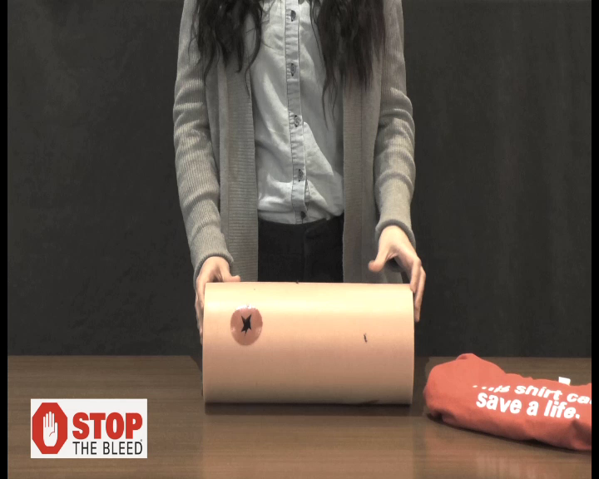
ABCs of Bleeding Control
Notes:
THERE IS NO SOUND TO THIS VIDEO – THE INSTRUCTOR SHOULD EXPLAIN THE STEPS THE IMMEDIATE RESPONDERS IS TAKING.
The demonstration in the video is moving at a slower pace as to show the process. Remind the participant that fast action must be accomplished to control bleeding.
In the next series of three slides you will see how to apply pressure to a bleeding wound.
Here you see the application of pin point pressure directly onto the site of bleeding. This is an effective method of controlling bleeding.

Slide 19
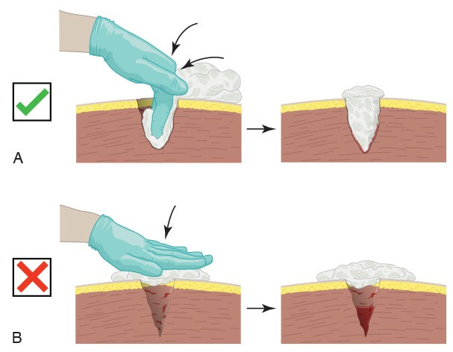
ABCs of Bleeding Control
C Compress - Packing
For large wounds, superficial
pressure is not effective
If bleeding is from a deep wound, pack gauze tightly into the wound until it stops the bleeding; hold pressure until help arrives
A bleeding control kit may contain hemostatic gauze (gauze that is coated with material that helps the blood clot). Both types of gauze can be used to pack the wound in the same fashion.
Notes:
If bleeding is from a cavity, superficial pressure may not work and you may need to pack the wound deeply and tightly. Be careful as there may be sharp objects or fragments of bone within the cavity. Once the bleeding stops, do not check the wound, simply hold pressure until help arrives.
The Texas School bleeding control kits may contain hemostatic gauze. Plain gauze and hemostatic gauze are used in an identical fashion as described on the slide.

Slide 20
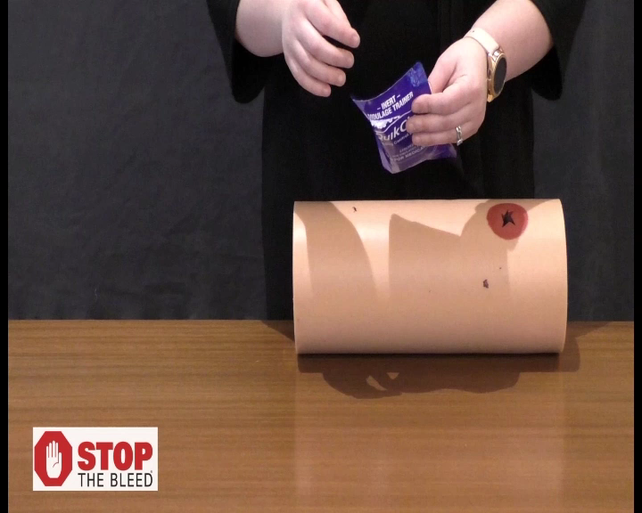
ABCs of Bleeding Control
Notes:
THERE IS NO SOUND TO THIS VIDEO – THE INSTRUCTOR SHOULD EXPLAIN THE STEPS THE IMMEDIATE RESPONDER IS TAKING.
The demonstration in the video is moving at a slower pace as to show the process. Remind the participant that fast action must be accomplished to control bleeding.

Slide 21
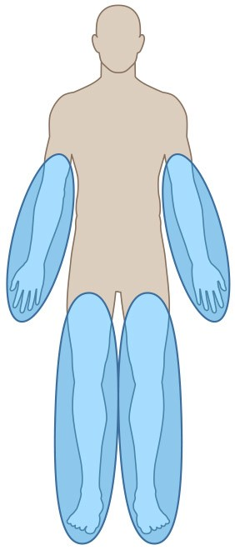
ABCs of Bleeding Control
C Compress - Packing
Arms and legs
Neck, armpits,
and groin
Body

Slide 22
ABCs of Bleeding Control
C Compress - Tourniquet
Apply 2 to 3 inches above wound
Do not place over the elbow or knee
Tighten tourniquet until bleeding stops
Do NOT remove the tourniquet
Notes:
Tourniquets should be considered for extremity bleeding that does not stop with pressure or packing, or, the situation does not allow you to maintain pressure on the wound.
Questions usually are asked about amputations and should you immediately use a tourniquet.

Slide 23
ABCs of Bleeding Control
C Compress - Tourniquet
Can apply to others or on yourself
Can be applied over clothes
Tourniquets HURT
A second tourniquet may be required to stop the bleeding
Notes:
The tourniquet should be applied 2-3 inches above the wound. Avoid placing a tourniquet onto a bony prominence or joint.
A tourniquet can be applied over light clothing however, remove any bulky clothing such as a jacket. if being placed over a pocket, ensure the pocket is emptied first otherwise the tourniquet will not be effective.
Continue tightening until the bleeding stops. Two tourniquets may be required to achieve hemorrhage control. It is a painful procedure, and severe pain should be expected. Do not remove the tourniquet until help arrives.

Slide 24
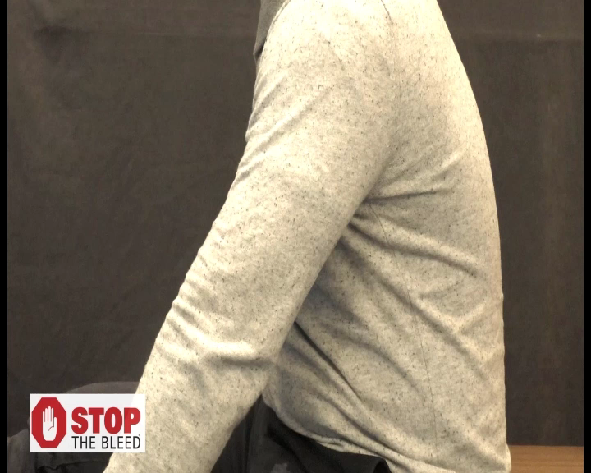
ABCs of Bleeding Control
Notes:
THERE IS NO SOUND TO THIS VIDEO – THE INSTRUCTOR SHOULD EXPLAIN THE STEPS THE IMMEDIATE RESPONDER IS TAKING.
The demonstration in the video is moving at a slower pace as to show the process. Remind the participant that fast action must be accomplished to control bleeding.

Slide 25
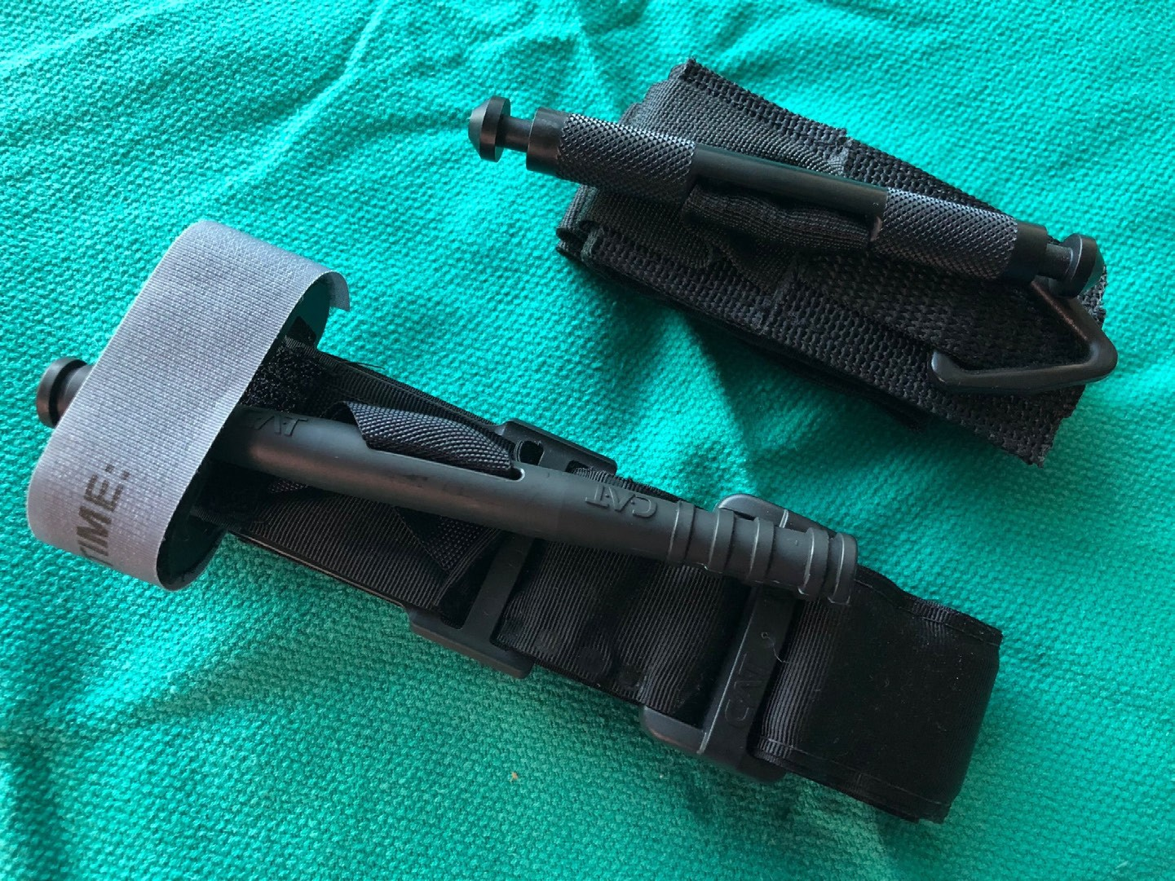
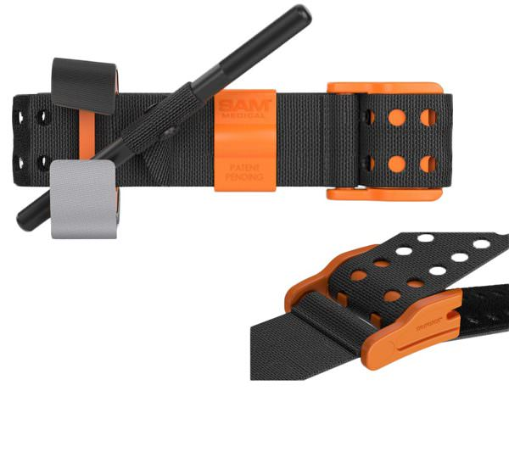
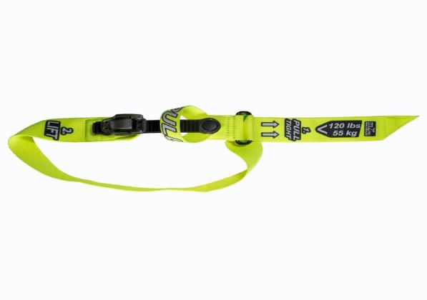
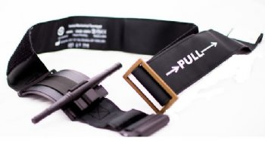
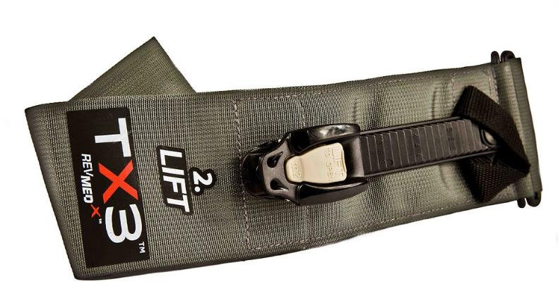
ABCs of Bleeding Control
SOFT-TT
CAT
RMT
SAM-XT
CAT
TX3
TMT
Notes:
Several tourniquet models are commercially available. The Committee on Tactical Combat Casualty Care also known as CoTCCC or TCCC is the resource the Committee on Trauma Stop the Bleed Program utilizes for direction regarding equipment.
This slide depicts tourniquets that are approved and listed on the TCCC’s adjunct formulary, however not every version of the approved tourniquet is shown. The next slide, Slide 26, provides a by name list of tourniquets approved through TCCC.
Our course teaches the use of a Windlass rod type tourniquet.
Instructors should discuss the mechanisms of the types of tourniquets and differentiate between windlass rod types and ratcheting types. In addition, the instructor should advise participants they may see any of these tourniquets in the field and should familiarize themselves with the tourniquet and how it works. The students in the school class should be taught to use the tourniquets available in their bleeding control kit.
It is important to stress that improvised tourniquets are difficult to make and to apply correctly, and may in fact increase the bleeding by compressing the venous structures. Their utility has not been scientifically proven and therefore caution should be used when considering their use.

Slide 26
CoTCCC Recommended STB Tourniquets
Recommended Non-Pneumatic Limb Tourniquets
Combat Application Tourniquet Gen 6 (CAT-6)
Combat Application Tourniquet Gen 7 (CAT-7)
Ratcheting Medical Tourniquet (RMT) Tactical
SAM Extremity Tourniquet (SAM-XT)
SOF Tactical Tourniquet–Wide (SOFTT-Wide)
Tactical Mechanical Tourniquet (TMT)
TX2 Tourniquet (TX2)
TX3 Tourniquet (TX3)
Notes:
https://www.deployedmedicine.com/market/11/content/100

Slide 27
CoTCCC Recommended STB Tourniquets
Recommended Pneumatic Limb Tourniquets
Delphi EMT (EMT)
Tactical Pneumatic Tourniquet 2” (TPT2)
Notes:
https://www.deployedmedicine.com/market/11/content/100

Slide 28
Bleeding control in children
In all but the extremely young child, the same tourniquet used for adults can be used in children.
For the infant or very small child (tourniquet too big), direct pressure on the wound as described previously will work in virtually all cases.
For large, deep wounds, wound packing can be performed in children just as in adults using the same technique as described previously.
Notes:
Techniques to control bleeding in the child are very similar to what has been presented for adults.
As long as they can be properly applied, the same tourniquet can be used in an adult or a child.
If the child is too small for the tourniquet to be applied properly, direct pressure on the bleeding wound will almost always work to control the bleeding.
Wound packing is the same in both adults and children.

Slide 29
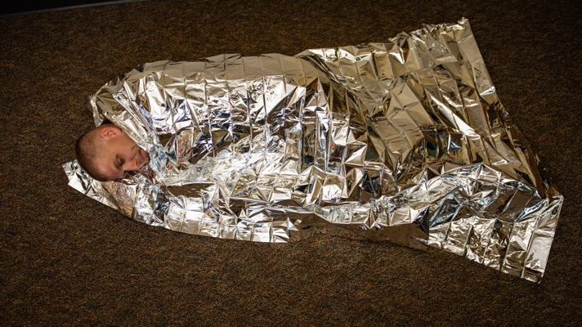
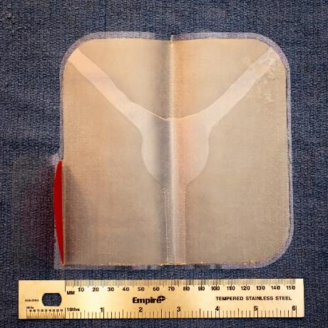
Texas School Bleeding Control Kit: Other Supplies
In addition to bleeding control equipment your school bleeding control kit may have:
  a thermal blanket
  a chest seal kit (ideally for medically trained responders)
The thermal blanket is designed to keep victims warm
The chest seal is designed to temporarily assist with certain types of chest wounds
Adhesive chest seal
Notes:
The Texas School Stop the Bleed legislation (HB496) signed into law requires certain materials in a bleeding control kit. The language in the law is noted below. We recommend school personnel be aware and familiar with the materials and equipment in their kit.
Wording from the legislation:
“(4)(d) A bleeding control station required under this section must contain all of the following required supplies in quantities determined appropriate by the superintendent of the district or the director of the school:
(1) tourniquets approved for use in battlefield trauma care by the armed forces of the United States;
(2) chest seals;
(3) compression bandages;
(4) bleeding control bandages;
(5) space emergency blankets;
(6) latex-free gloves;
(7) markers;
(8) scissors; and
(9) instructional documents developed by the American College of Surgeons or the United States Department of Homeland Security detailing methods to prevent blood loss following a traumatic event.
(e) In addition to the items listed under Subsection (d), a school district or open-enrollment charter school may also include in a bleeding control station any medical material or equipment that:
(1) may be readily stored in a bleeding control station;
(2) may be used to adequately treat an injury involving traumatic blood loss; and
(3) is approved by local law enforcement or emergency medical services personnel.”

Slide 30
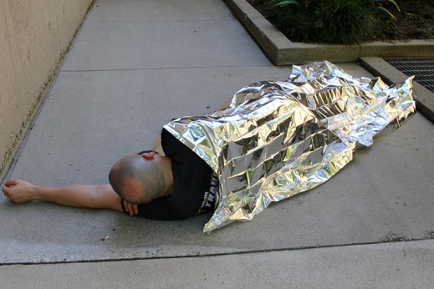
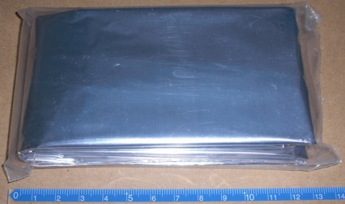
Avoiding Hypothermia: Thermal Blankets
Patients can lose body heat rapidly after an injury
This can lead to impaired bodily functions and even death
Life threatening heat loss can even occur on a hot summer day
Once the bleeding has been stopped, do what you can to prevent heat loss
  Remove wet clothing
  Cover with a warm blanket or clothing
  Shelter from the elements
Notes:
Preventing hypothermia (low body temperature) is important. Patients who are in shock (a life threatening condition caused by blood loss and other severe injuries) can develop severe hypothermia. Hypothermia can lead to impairment of body function and even death. This can occur in situations of severe injury (shock), even with warm temperatures. Once the bleeding is controlled, remove wet clothing and cover with a thermal blanket, sheltering the injured person from the elements.

Slide 31
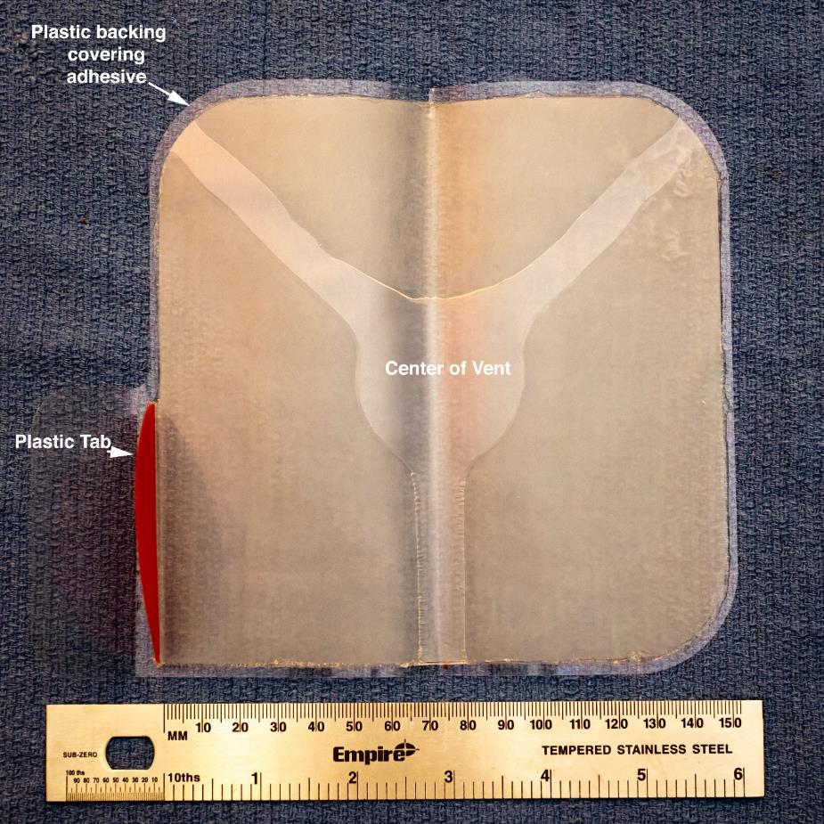
Instructions Chest Seal: For Medically Trained Responder
Clean and dry skin around wound
Grasp the plastic tab
Peel backing away from seal
Apply on wound adhesive side down, centering the vent over the wound
Repeat for other chest wounds
Evaluate the patient for improvement
If the patient condition worsens, remove chest seal
Notes:
The Chest Seal in the bleeding control kit is designed to temporarily assist medical providers with certain types of chest wounds. School personnel should be familiar with their particular type of chest seal device. The seal should be placed over clean, dry skin around the wound. In general, peel the plastic backing away from the adhesive seal. Apply the chest seal with the adhesive side on the skin, centering the vent over the chest wound. This may be repeated for other chest wounds. The patient must be monitored for improvement. If the patient’s condition worsens, the chest seal should be removed. Ideally, these are decisions for a medically trained first responder.

Slide 32
FAQs
Impaled objects?
Improvised tourniquets?
Loss of arm or leg?
Pain?
Other questions?
Notes:
These are common concerns. Take the time to review these carefully with your students.
Impaled objects should be left in place and not removed. The immediate responder could apply a tourniquet above the object. Professional medical personnel, Fire and EMS, are trained to treat impaled objects.
Improvised tourniquets – notes from slide 25 should be reiterated
Loss of arm or leg is referring to the fear that a tourniquet could result in the victim losing their arm or leg if the immediate responder places a tourniquet on the victim. Reassure them that placing a tourniquet on a victim will save their life and far outweighs the loss of an extremity. There are studies available regarding length of time of tourniquet placement.
Victims will experience pain with direct pressure, wound packing, and tourniquet application. It is important to manage their expectations regarding all three techniques for controlling bleeding.
Other questions can and will be asked, please note questions and send to unique questions or questions that you cannot answer to STB staff to provide a response for you and for future course updates.

Slide 33
For more information:
BLEEDINGCONTROL.ORG
STOPTHEBLEED.ORG
Notes:
Encourage participants to visit stopthebleed.org This site is maintained by the American College of Surgeons and is updated frequently with new information regarding this important topic.
Kits are available at the Bleeding Control Website.

Slide 34
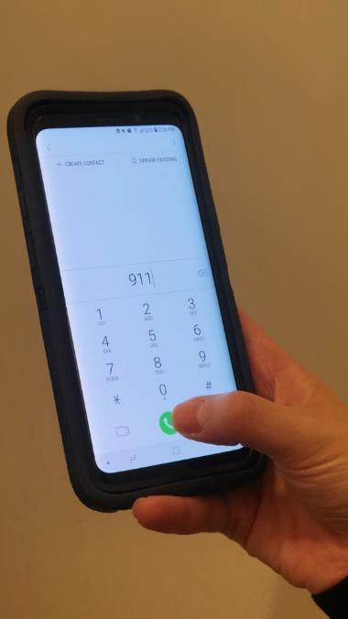
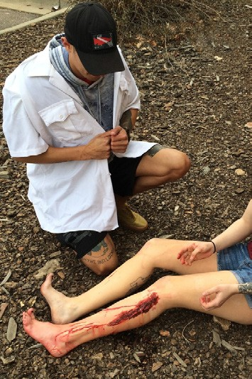
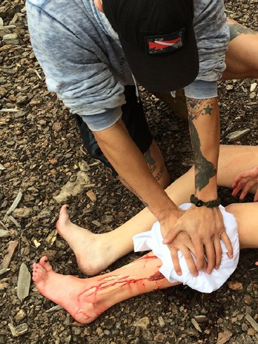
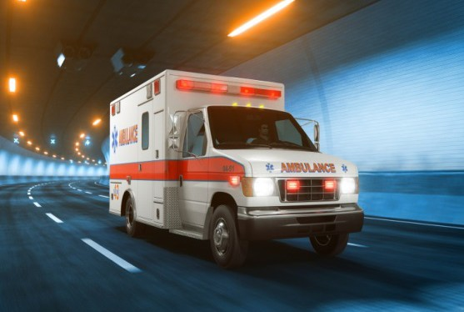
Summary
Personal safety A Alert 911
B Find bleeding C Compress with
pressure and/or packing
C Compress with a tourniquet
Wait for help to arrive
Notes:
Reinforce the framework on this slide:
This course is designed to help you respond to a potentially deadly injury.
First, make sure the scene is safe. You must ensure your own safety before trying to help someone else.
Next, get help. Call or have someone call 911 for assistance. Make every effort to assure help is on the way as you proceed to the next step.
Look for any bleeding and assess its severity.
Once you have located a source, control of the bleeding will involve the application of direct pressure, the packing of an deep wound , application of a tourniquet, or a combination of all of these techniques.

Slide 35
The only thing more tragic than a death… is a death that could have been prevented.
Notes:
The goals of this program were to recognize life-threatening bleeding and to take the appropriate steps to control bleeding until help arrives.
With this training, you can save lives.

Slide 36
Small Groups for skill training and education
Wound packing and direct pressure
Tourniquet application
Notes:
For the hands on skills education: 1) describe the need for each of the skills and their importance, 2) demonstrate the technique for the students without description, 3) demonstrate the skill describing the steps as you perform it, 4) have the students describe and discuss the skills, and 5) observe the students perform the skills of wound packing and tourniquet application. Lastly, encourage questions and discussion.

