Slide 1



Version 3
StoptheBleed.org
Content and Illustrations © American College of Surgeons (ACS). All rights reserved. Material cannot be used, reproduced, distributed, or displayed without the express written permission of the ACS.
STOP THE BLEED® is a registered trademark of the U.S. Department of Defense, Defense Health Agency. All rights reserved. © DoD.
The American College of Surgeons’ Stop the Bleed program is operated pursuant to a licensing agreement granted it by the Department of Defense
Notes:
STOP THE BLEED Title Slide
Key content elements
URL, Logos, ACS Branding
Instructor considerations
Remember to point out the proprietary nature of this presentation and must be used appropriately.
Situational scenarios for presenting
N/A
Guiding discussion areas
Why are we here? This is an important empowerment step before you even start the presentation.
The instructor notes will ensure all instructors address key content elements and maintain the ACS STB Course continuity. They are not intended to be read but should be used as guidance. The instructor should be responsive to the audience and the environment and make necessary and appropriate adjustments.
This presentation includes the slide set you will need to deliver the didactic portion of the Version 3 (late 2024) ACS Stop the Bleed Basic course and key instructor notes to assist you with the delivery of this material. ​ Consider downloading and printing these slides as a handout for course participants. Please note that all material included in this slide presentation and all content on the instructor portal is proprietary to the American College of Surgeons, trademarked by the ACS, and any use outside of instruction with the ACS is strictly forbidden, and will be met with legal action. ​

Slide 2

Bleeding emergencies can be graphic and disturbing
Notes:
Graphic Images Noted
Key content elements
It Is essential to note that images may be disturbing but preparing learners for what they might see is necessary.
Instructor considerations
Injuries vary—important to impart that some can be serious, and others not as much, but all bleeding should be stopped. Keeping calm is an important step.
Situational scenarios for presenting
No matter the setting, we must be prepared, and the steps are simple enough.
Guiding discussion areas
Perhaps asking about possible scenarios they may encounter in THEIR everyday lives—students, workplace, community, sports, outdoors, crafts/avocations, etc.
This presentation will involve artistic drawings and descriptions of injuries and bleeding. Although this may be disturbing to some people, it is necessary to effectively prepare students for actual bleeding situations. The following few slides might show some images of bleeding injuries. These injuries can look severe or appear serious, and that's okay. Being prepared for what you might see in an emergency is vital.​ Remember, the goal is to stay calm and help the person control their bleeding until help arrives. We'll walk you through some simple steps that anyone can learn.​

Slide 3
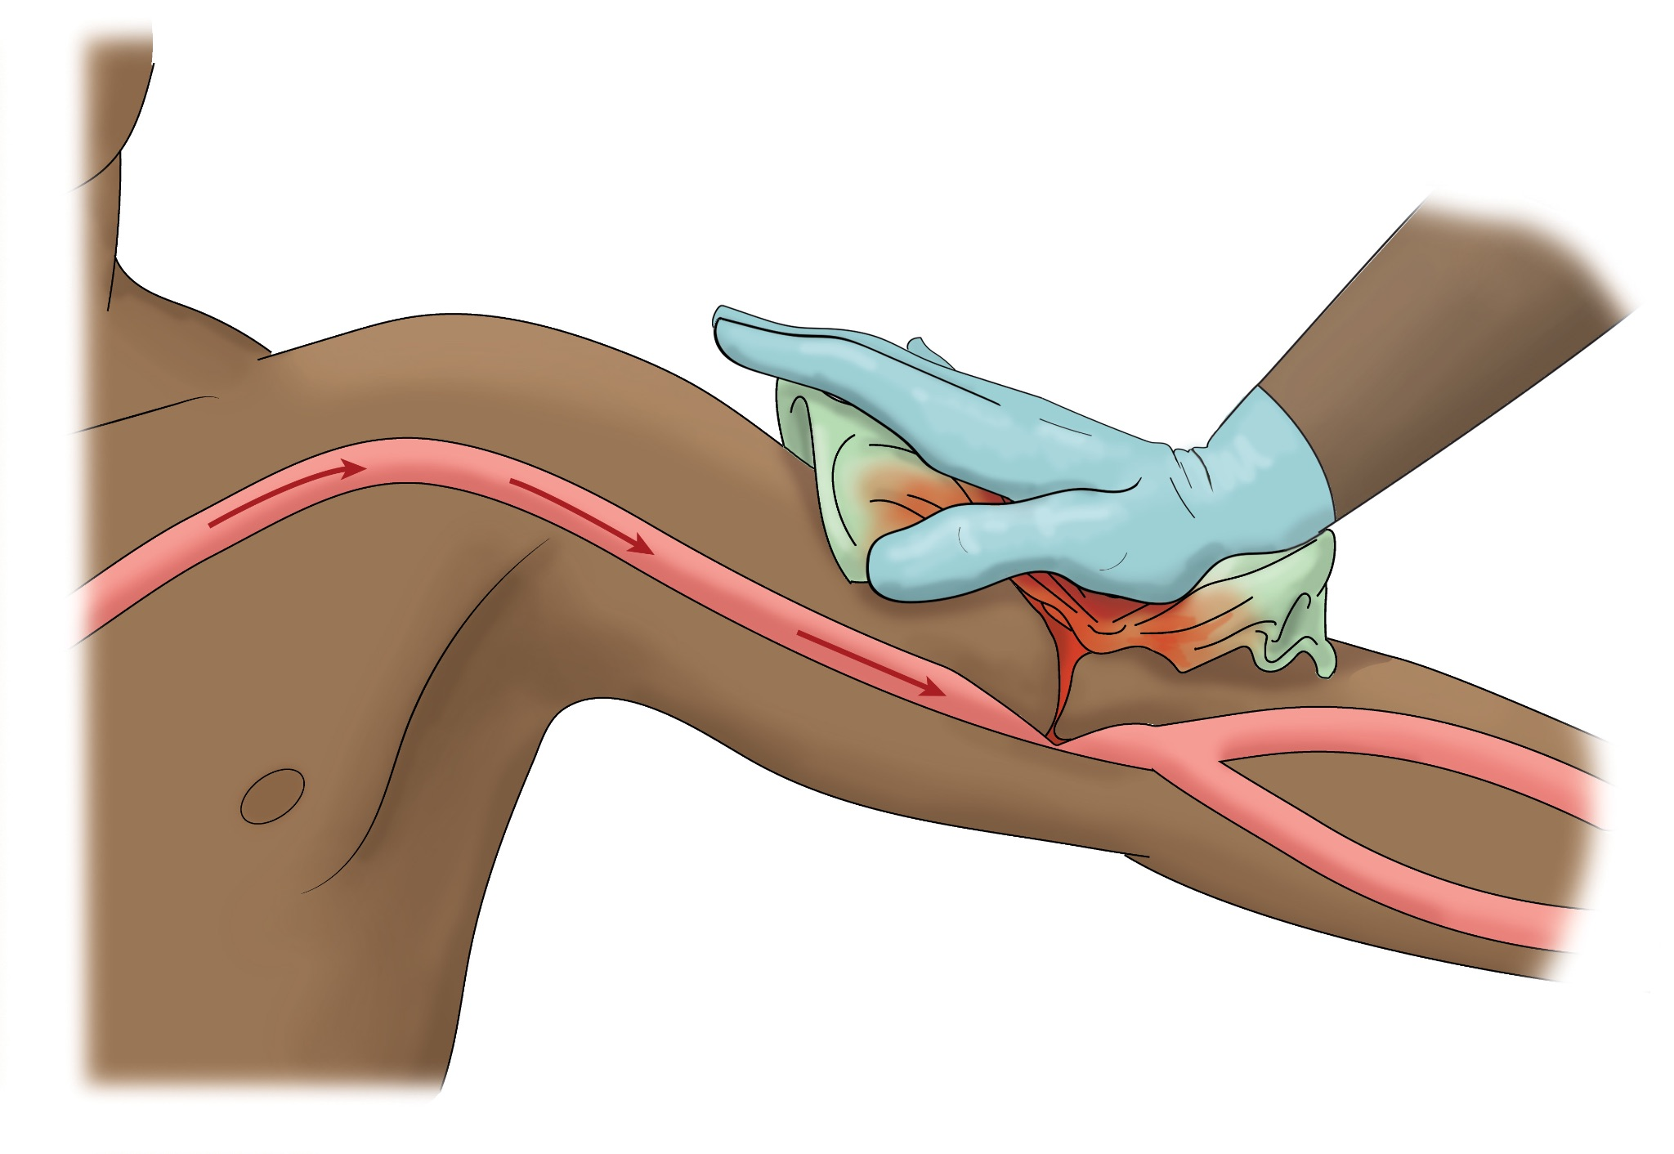
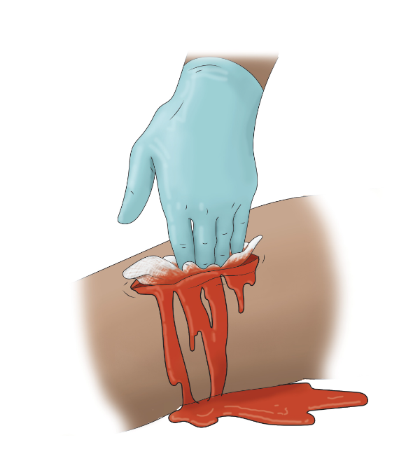
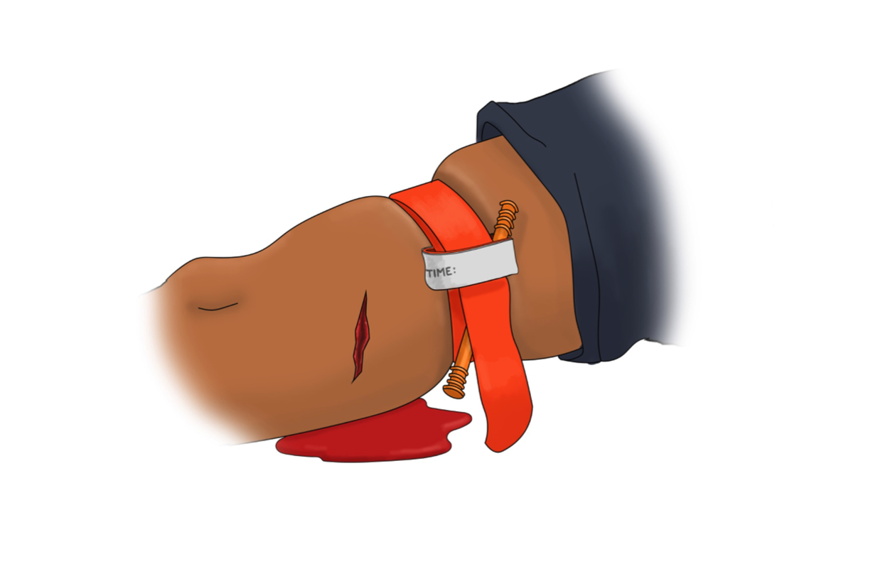
Bleeding can kill, but YOU can
Stop the Bleed
©ACS
©ACS
©ACS
Notes:
Bleeding can kill
Key content elements
Image of bleeding and a person acting with gloves; puddle of blood, open wound with active bleeding, cut clothing, tourniquet application.
Instructor considerations
This slide is about empowerment. Bleeding is one of the biggest dangers after a serious injury. If someone loses too much blood, they can go into shock or even die. Severe bleeding can lead to death in just a few minutes. The good news is that you can be a hero in an emergency! This course will teach you some simple steps to control bleeding until help arrives. By applying pressure directly to the wound and following the other steps, you can Stop the Bleed and save someone's life.​
Situational scenarios for presenting
N/A
Guiding discussion areas
Speak to the importance of acting quickly to identify and stop the bleeding empowerment and enabling.
Upon completion, the participant can be an immediate responder.
This course will provide the participant three mechanisms to effectively control bleeding: direct pressure, wound packing, and tourniquet application.

Slide 4
Where can you use this training?
Notes:
Where can you use this training?
Key content elements
Words only— you should engage the audience for their first steps. ASK THEM THIS QUESTION and hear a few answers.
Instructor considerations
Know and understand your audience and use examples that reflect where bleeding control may be necessary for their environment, use relevant examples, i.e., schools and playgrounds, manufacturing machinery, restaurants and kitchen injuries, home projects, etc. Understand your audience—include age level, environmental examples, everyday or unusual possibilities.​ Speak to the importance
Situational scenarios for presenting
NA
Guiding discussion areas
What are some everyday situations where serious bleeding might occur?
(Examples: car accidents, kitchen injuries, falls, active violence, workplace accidents, natural disasters, etc.)
How much time do you think a person has before severe bleeding becomes life-threatening?
(Answer: In some cases, as little as 3-5 minutes.)
Speak about the importance of quickly identifying and stopping bleeding. Use this course to empower and enable the participant to act during a bleeding emergency.

Slide 5
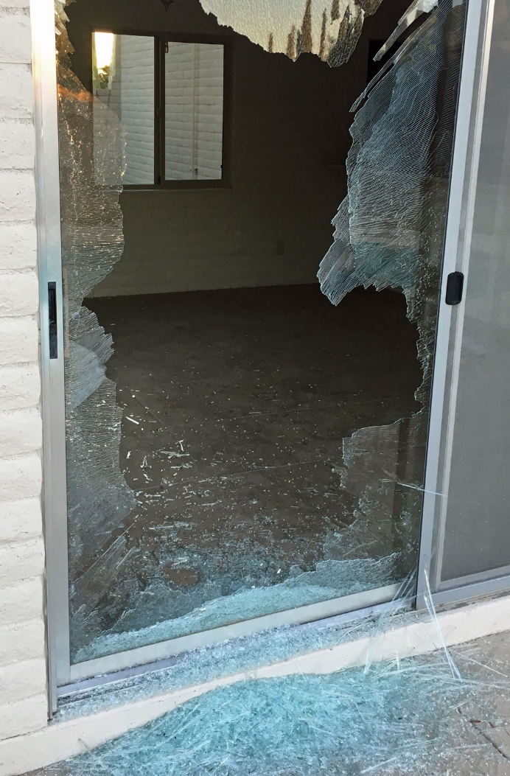
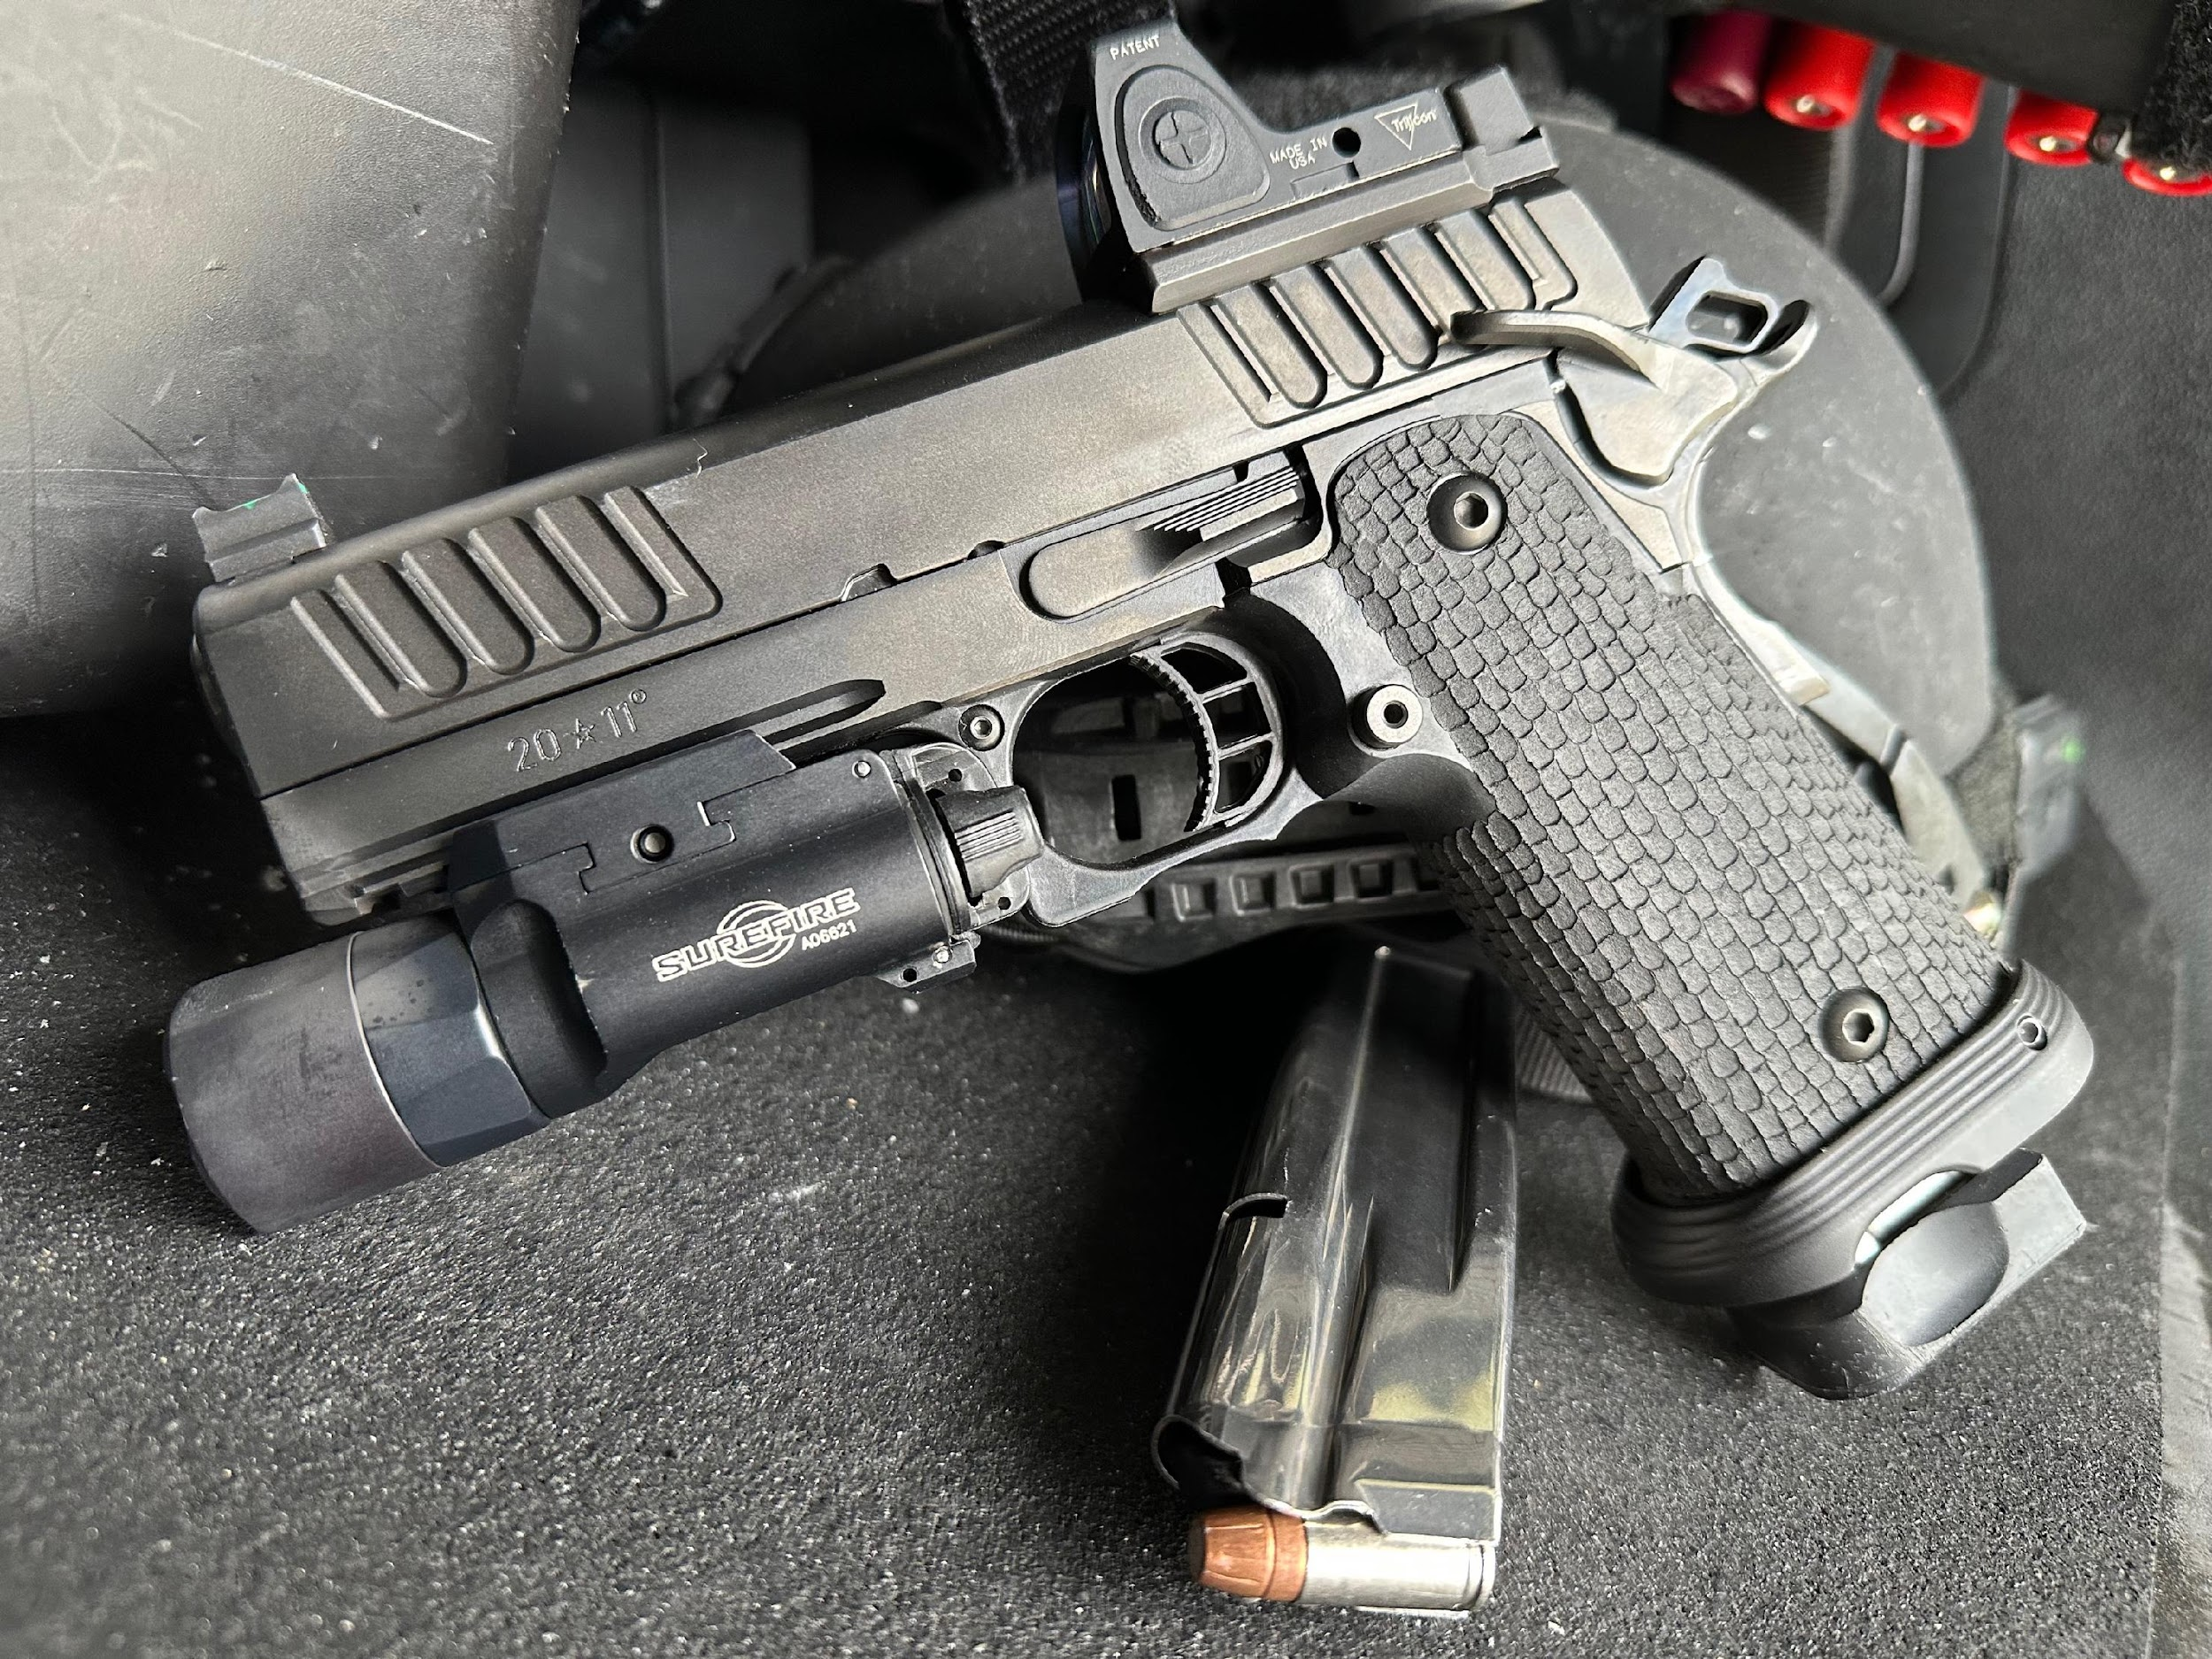
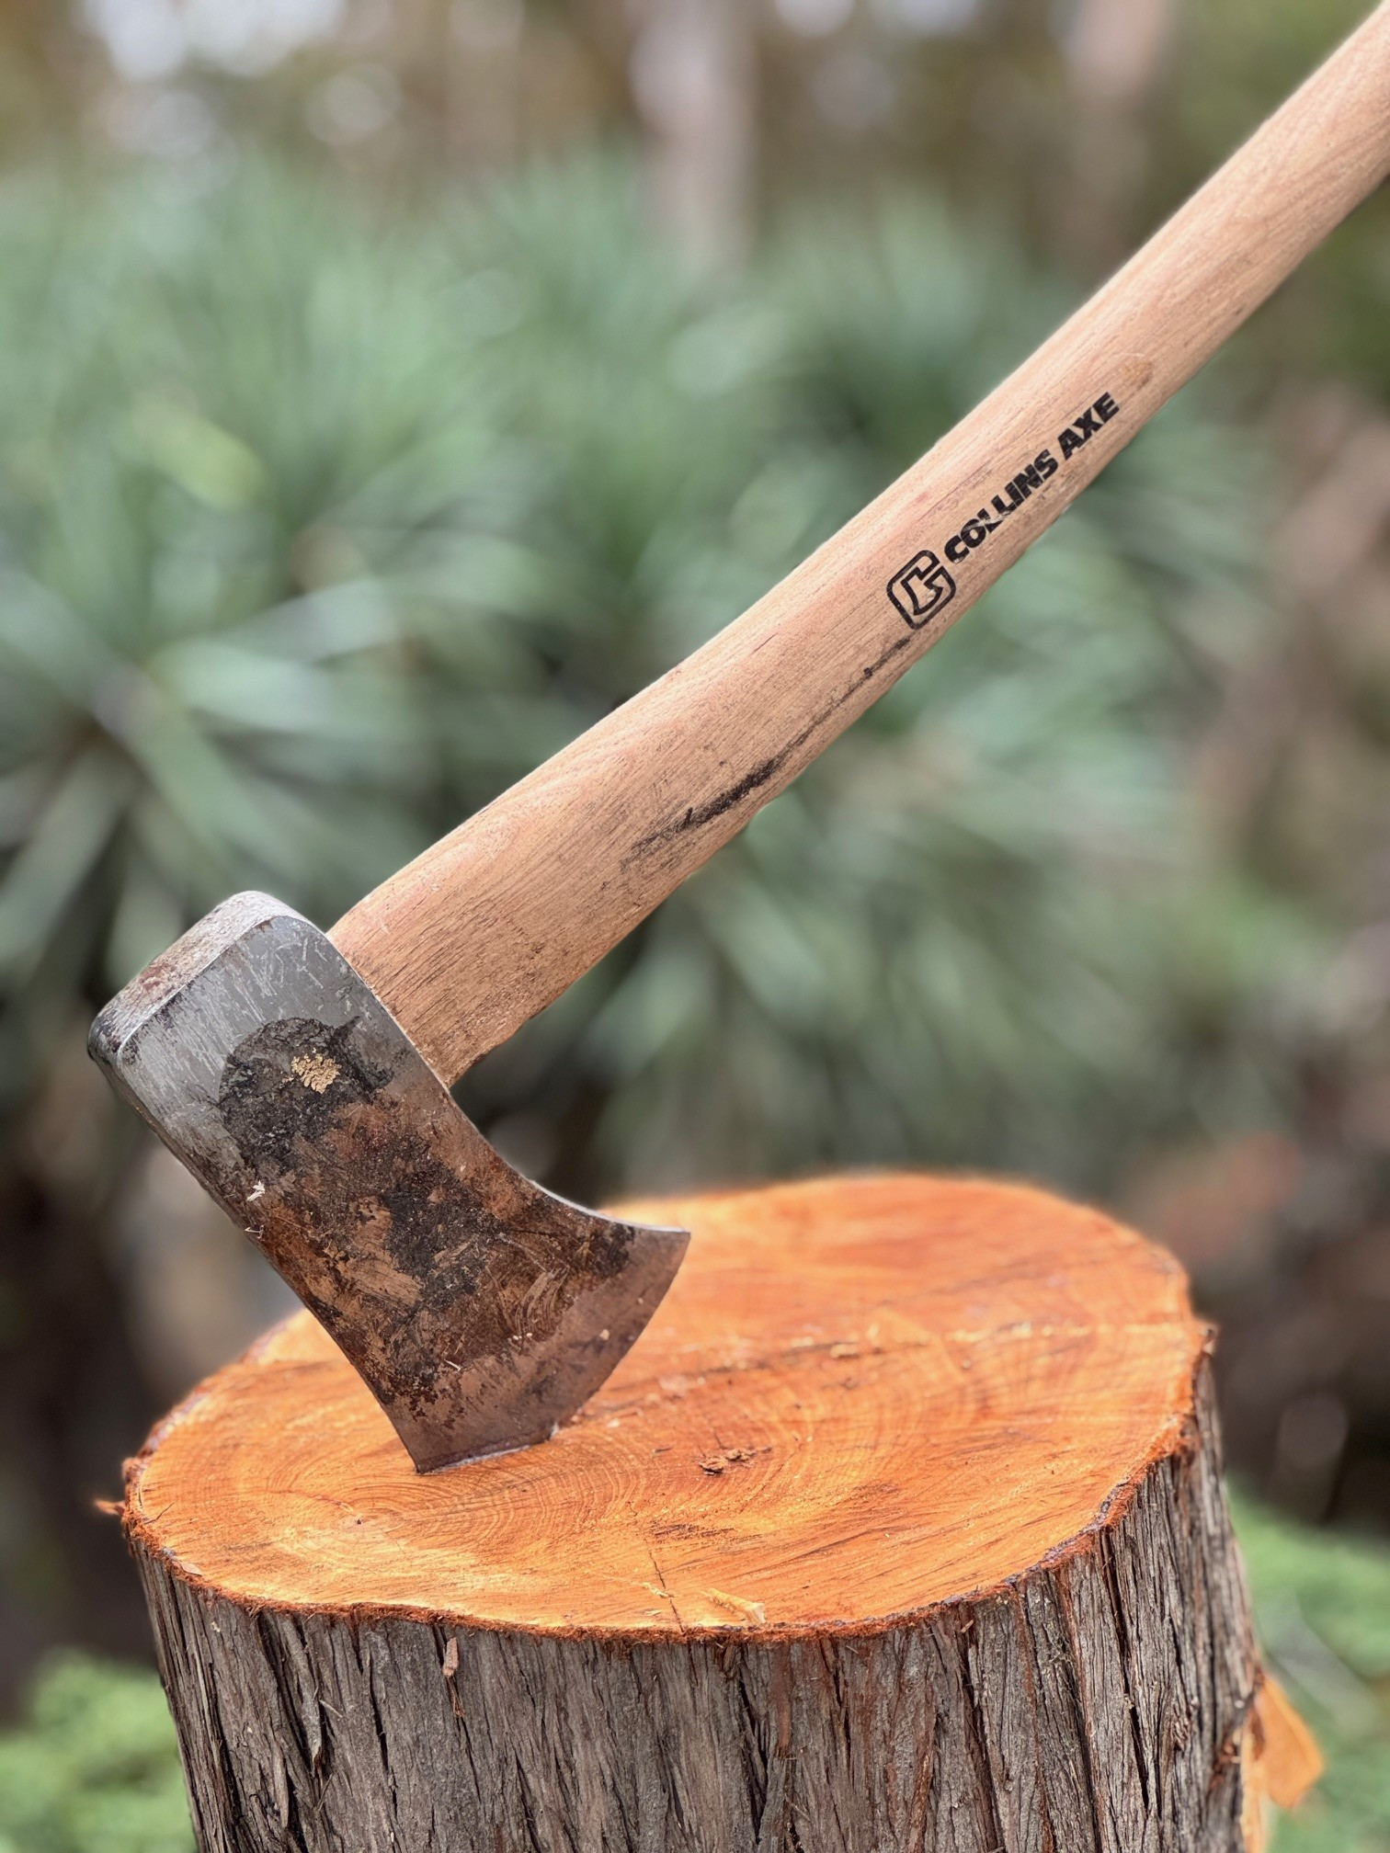
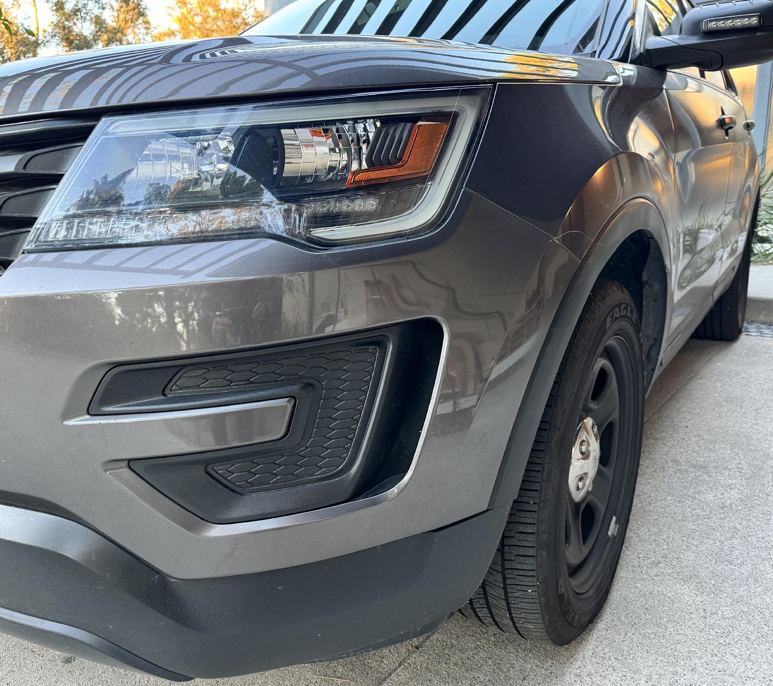
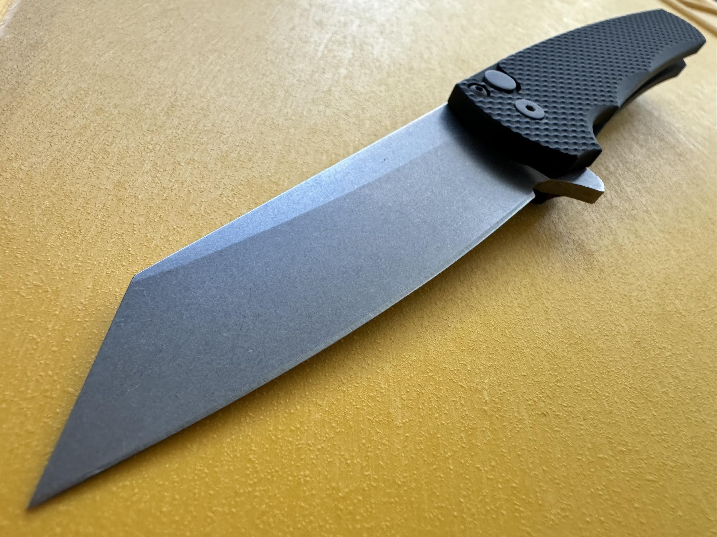
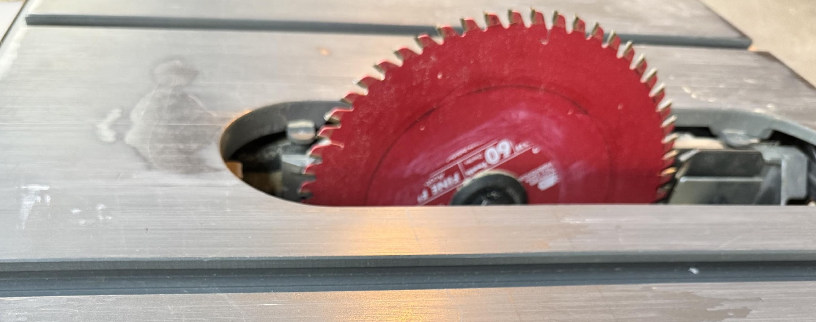
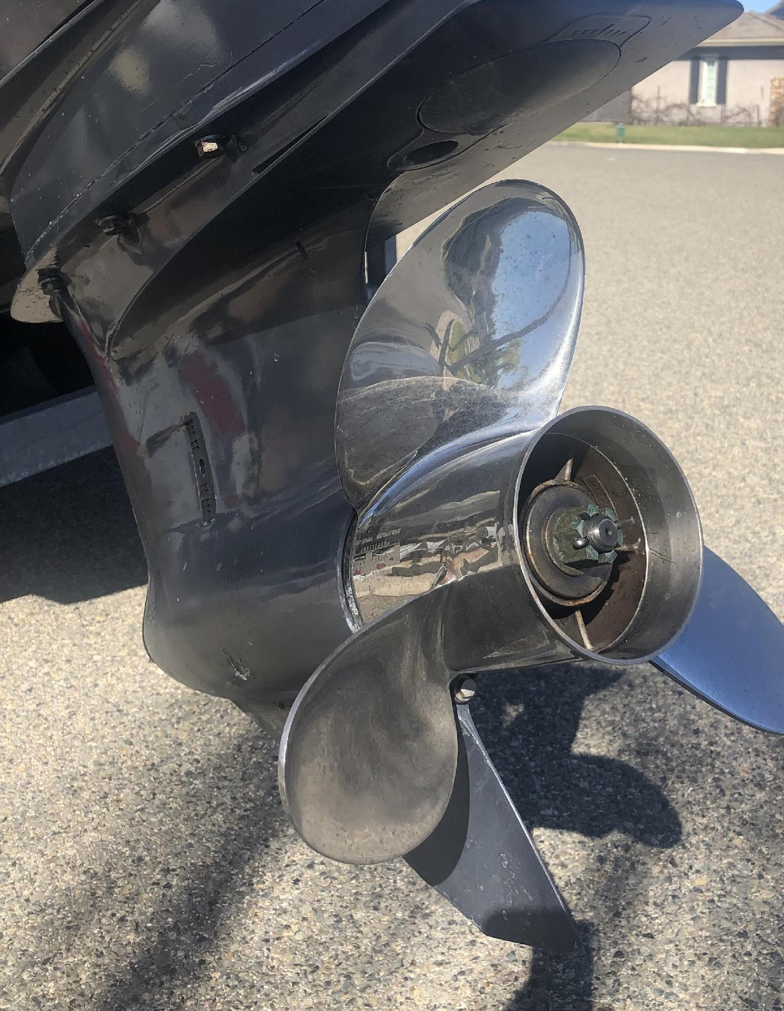
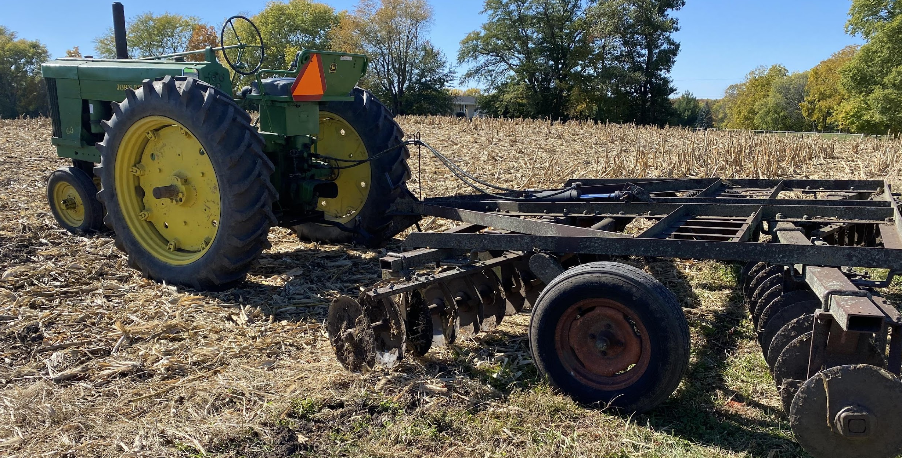
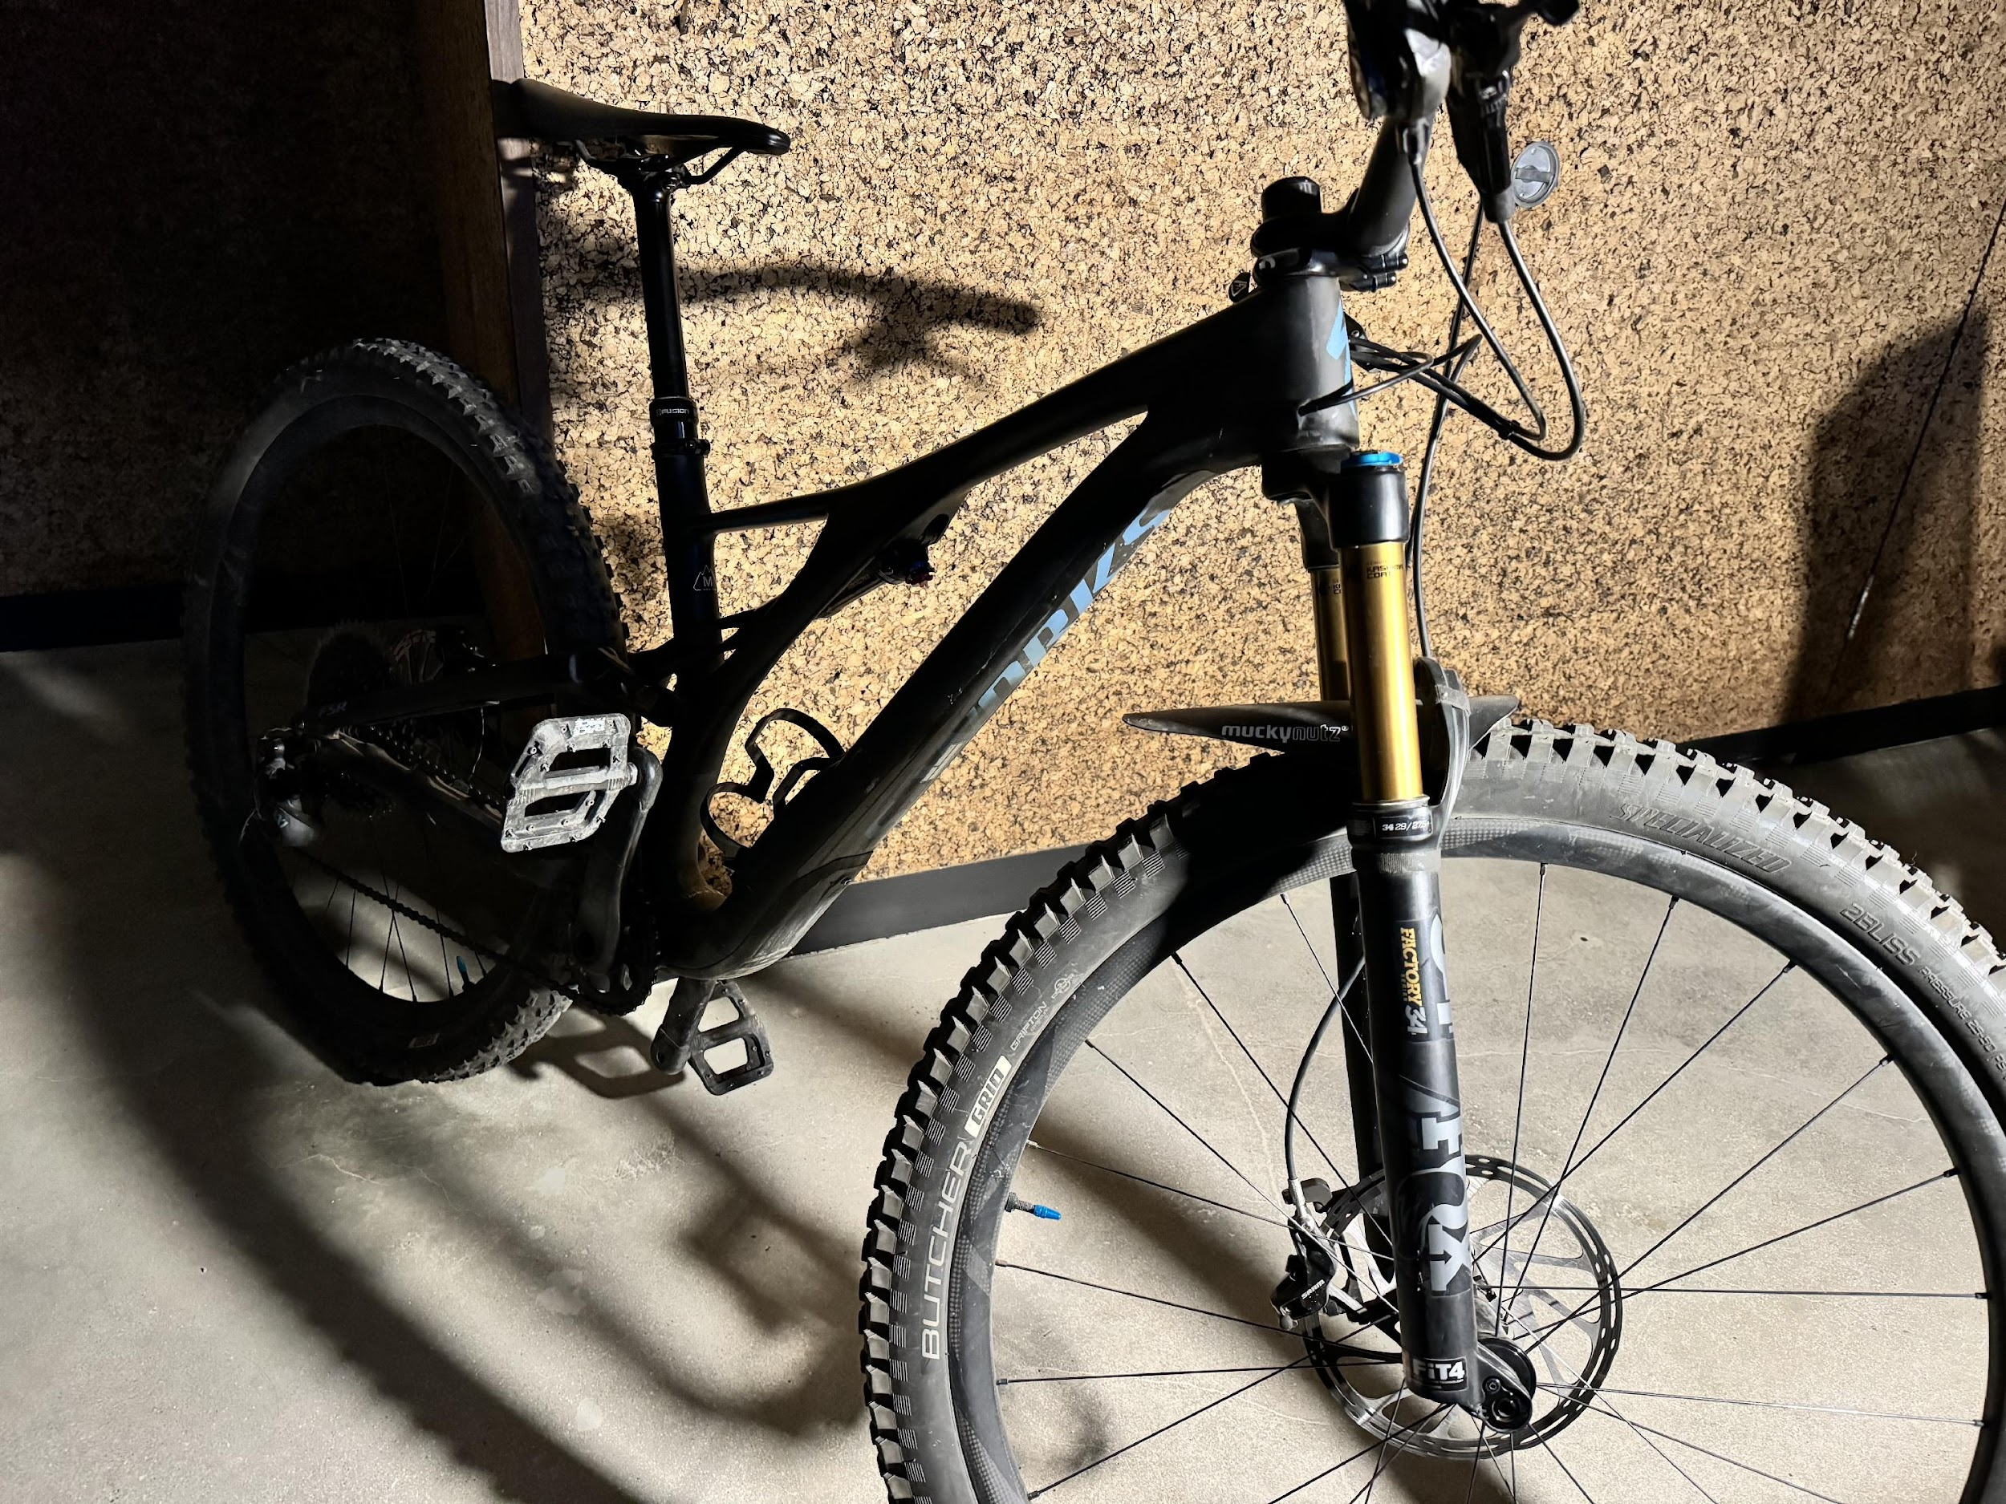
3.2"3.2"
Notes:
Bleeding emergency examples
Key content elements
Images to demonstrate the diversity of injury causes (from 12:00 around knives/sharps, sport and boating, farming, carpentry and woodshop, automobile crashes, broken class, violence, and more
Instructor considerations
Bleeding emergencies can happen anywhere, at any time. These pictures show just a few examples, from accidents in the kitchen or while biking to injuries from tools or even a fall. That's why it's important to be prepared to act quickly if you see someone bleeding badly. Knowing what to do lets you take control of the situation and help save a life, no matter where the injury happens.​
This slide indicates the varying causes of severe bleeding. If the instructor wants to add a different mechanism, they should contact the ACS Stop the Bleed Program and stopthebleed@facs.org
Situational scenarios for presenting
Imagine your last 48 hours—were you in any of these environments? Were your parents? Kids? Siblings? Students? Coworkers or friends?
Guiding discussion areas
Can you think of situations where severe bleeding might occur (e.g., car accidents, workplace injuries, active shooter events)?
Why is immediate action crucial in severe bleeding situations?
Why do you think knowing how to stop severe bleeding is important?

Slide 6

©ACS
Notes:
Time—the clock
Key content elements
Severe bleeding can become fatal in as little as 3-5 minutes.
This is faster than most emergency medical services (EMS) can arrive, making bystander intervention crucial in saving lives.
Example: If someone suffers a deep wound in a car accident, waiting for paramedics without intervention could lead to life-threatening blood loss before they arrive.
Instructor considerations
Too late is too little. It’s important to remember that time is blood loss, and STB can help you help others. Time is critical to the victim, and acting quickly is important.
Controlling bleeding within the first few minutes dramatically increases survival chances.
Acting within the first 60 seconds—by applying pressure, packing the wound, or using a tourniquet—can be the difference between life and death.
The average EMS response time in the U.S. is 7-10 minutes but varies by location and traffic conditions.
In remote areas or mass casualty events, it could take even longer.
Every second counts! Bystanders must act immediately rather than waiting for help.
Situational scenarios for presenting
When presenting bleeding emergencies, use situational scenarios that help make the training engaging and practical. These scenarios should be realistic, relatable, and applicable to everyday life. Guiding discussion areas

Slide 7
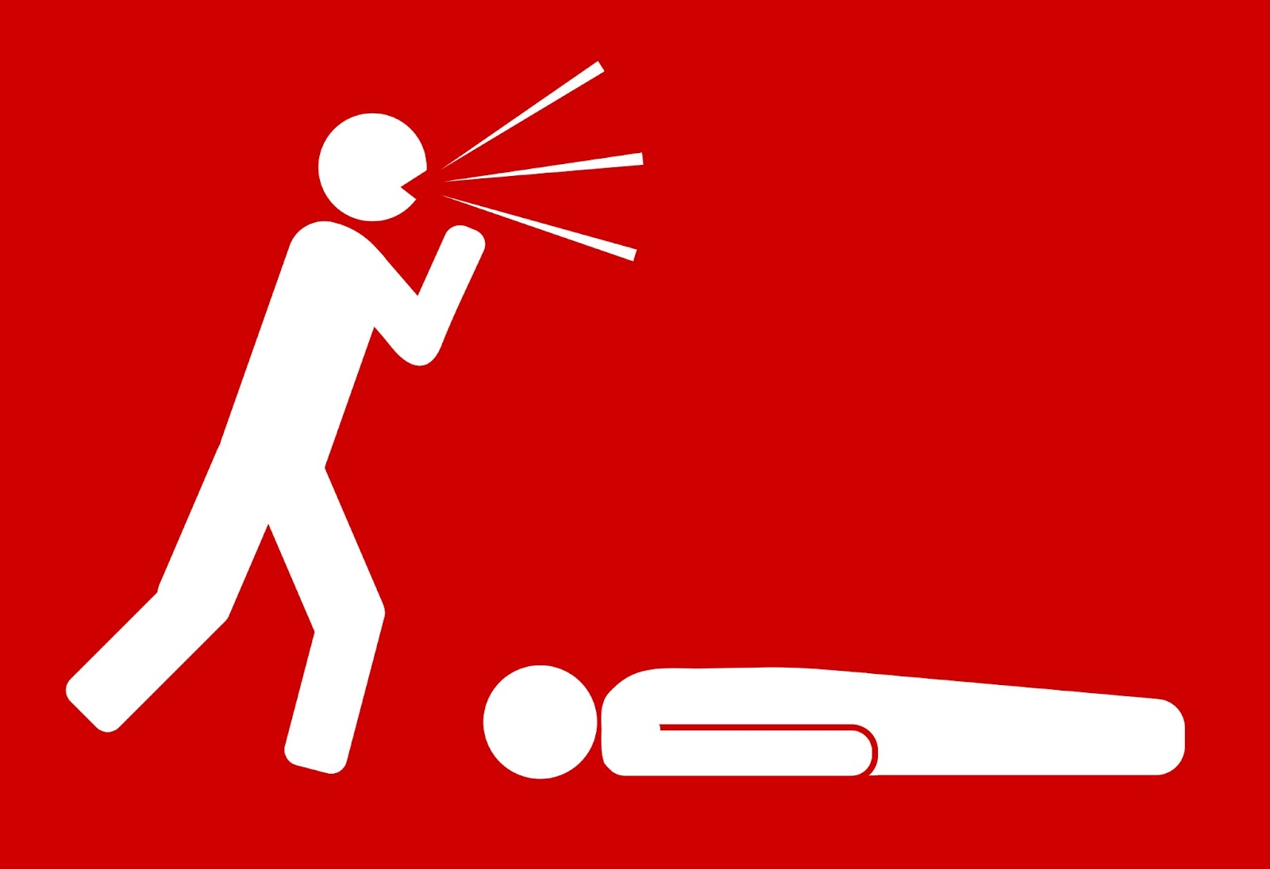
Alert Emergency Medical Services
Notes:
Initial Steps: Calling EMS
Key content elements
You are being empowered and trained to help, but your help is a bridge.
Instructor considerations
Even though you can take steps to control bleeding, it’s vital to call for help as soon as possible as the victim requires advanced medical care. The process for alerting emergency medical services can vary depending on your location. EMS professionals are specially trained to provide advanced care and transport the injured person to the nearest hospital or facility. Law enforcement is critical in responding to bleeding emergencies, often arriving before EMS. Their involvement can significantly impact survival outcomes by providing immediate aid and securing the area for further medical response. In an emergency, every minute counts. Remember, your quick action in calling for help can make a big difference.
Situational scenarios for presenting
N/A
Guiding discussion areas
N/A

Slide 8
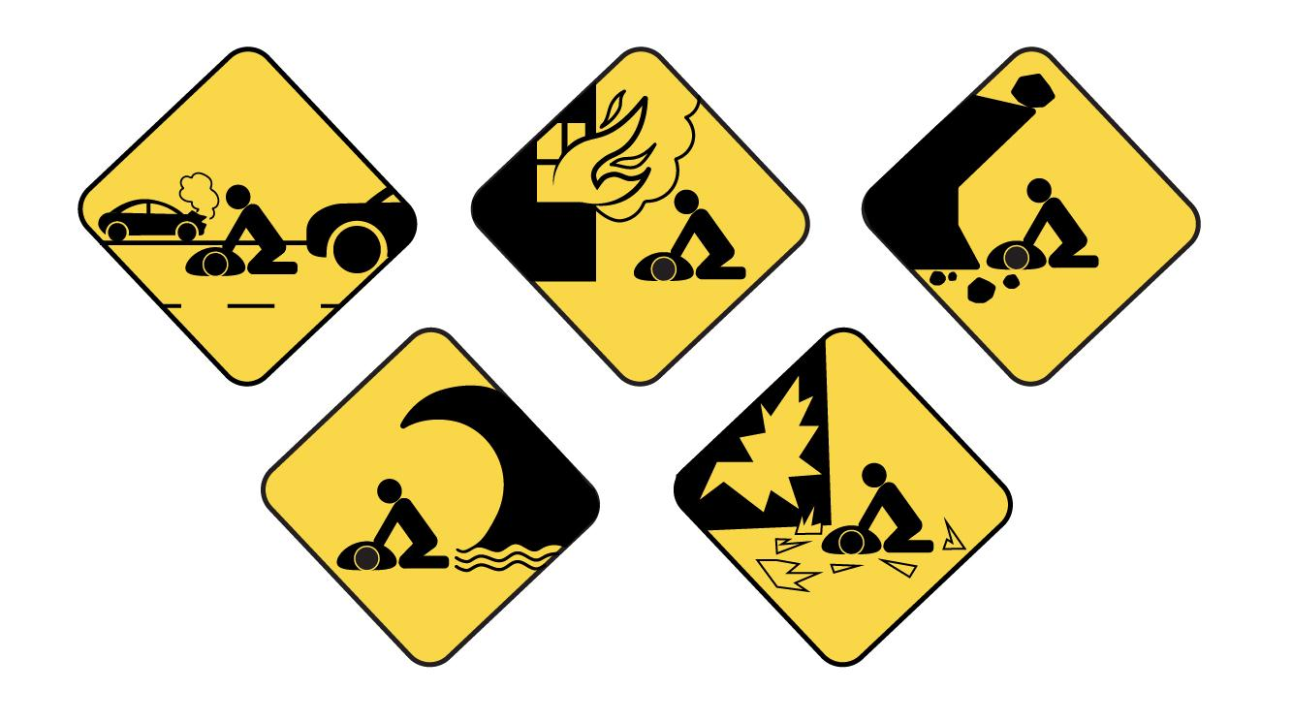
Scene Safety
©ACS
©ACS
©ACS
©ACS
©ACS
Notes:
Assess the scene for safety.
Key content elements
You can’t help if you’re also injured.
In a bleeding emergency, ensuring scene safety is paramount and a critical step before moving into action. This ensures that the responder and the victim are protected from additional harm.
Instructor considerations
Before you help someone who is bleeding, ensuring the scene is safe for you is crucial. This means looking out for any dangers that could also hurt you. For example, is there traffic nearby? Are there any electrical hazards? Waiting for help to arrive is best if the scene isn't safe. You can't help someone if you get hurt yourself!​
Remember that something caused the victim to bleed, and that mechanism of injury is still present and could potentially hurt you or others.
Effective scene safety and bleeding control can be the difference between life and death in trauma situations, especially when first responders are unavailable or delayed.
Situational scenarios for presenting
Provide examples for scene safety.
Traffic and cars, industrial dangers, fire/smoke, outdoor and weather, glass, violence, etc., nearby.
Guiding discussion areas
What are the first things you should assess when you arrive at the scene of a bleeding emergency?
How would you determine if there are immediate hazards to your safety or the victim’s safety at the scene?
How does the presence of bystanders affect your ability to manage the situation safely?
How can you ensure that you do not become another victim while managing a bleeding emergency, especially in environments with traffic, dangerous debris, or unstable structures?
In what situations might you need to move the victim?
These questions encourage critical thinking and open discussion about the importance of scene safety and its role in successful trauma care.

Slide 9
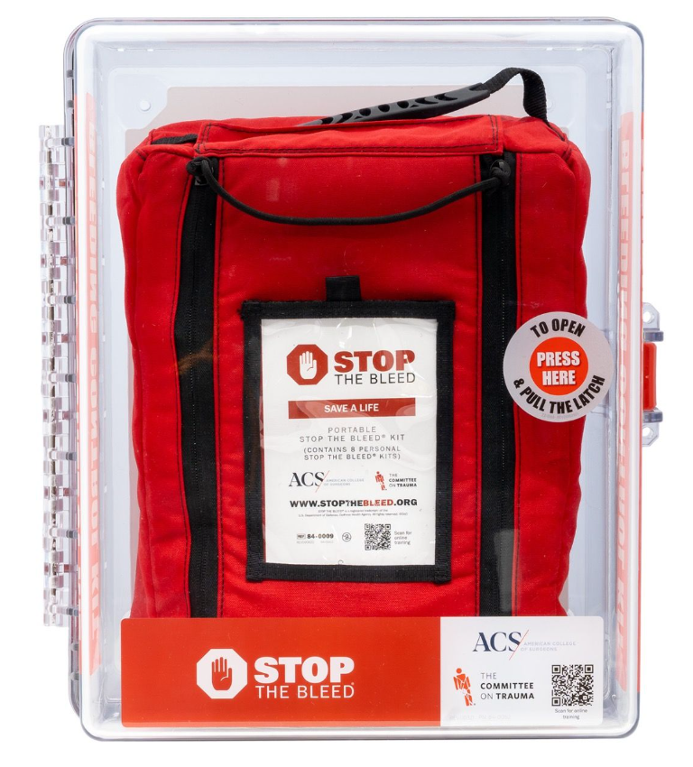
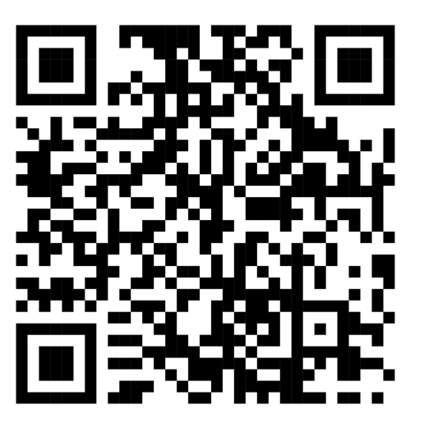
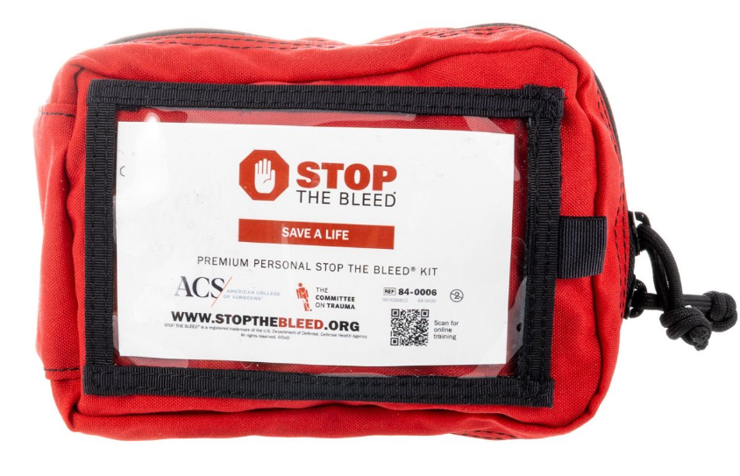
Notes:
Look for bleeding control kits. They can be found as wall-mounted or individual kits. They will contain gloves, wound packing materials, and a tourniquet if available. If no kit is available, you can use whatever cloth material you have to pack a bleeding wound.
ACS Stop the Bleed equipment
Key content elements
The American College of Surgeons, Committee on Tactical Combat Casualty Care, and Combat Casualty Care Research Program have recommended tourniquets based on testing and use.
Instructor considerations
There are other options when purchasing bleeding control equipment; however, the quality of the equipment may not be tested, resulting in faulty equipment. If the equipment does not have the DoD or ACS STB logo, it has not been vetted and may fail during use.
Equipment can be ordered through stopthebleed.org by viewing the shop tab at the top of the website.
The QR Code will take the participant to the ACS STB storefront to order approved ACS equipment.
Situational scenarios for presenting
Non-recommended tourniquets have failed when applied, causing further injury and not stopping bleeding.
Guiding discussion areas
None

Slide 10
Personal Protective Equipment
©ACS
Notes:
Personal Safety/Hygiene
Key content elements
Keeping rescuers/immediate responders safer
Instructor considerations
Note that we already spoke about scene safety, but it’s important to remember personal safety. Whenever possible, it's a good idea to wear gloves when helping someone who is bleeding. This will help protect you from germs and diseases in the blood. If you don't have gloves, don't let that stop you from helping! You can use a clean cloth or even a piece of clothing to apply pressure to the wound. The most important thing is to stop the bleeding. However, if you do have contact with someone's blood, be sure to tell a medical professional later. They can advise you on any precautions you might need to take.​
Handwashing (before/after) should be encouraged here.
Situational scenarios for presenting
It is reasonable to discuss getting attention for yourself afterward.
Guiding discussion areas
In a situation where gloves or other PPE is unavailable, what alternative actions can you take to reduce the risk of exposure to bloodborne pathogens?

Slide 11
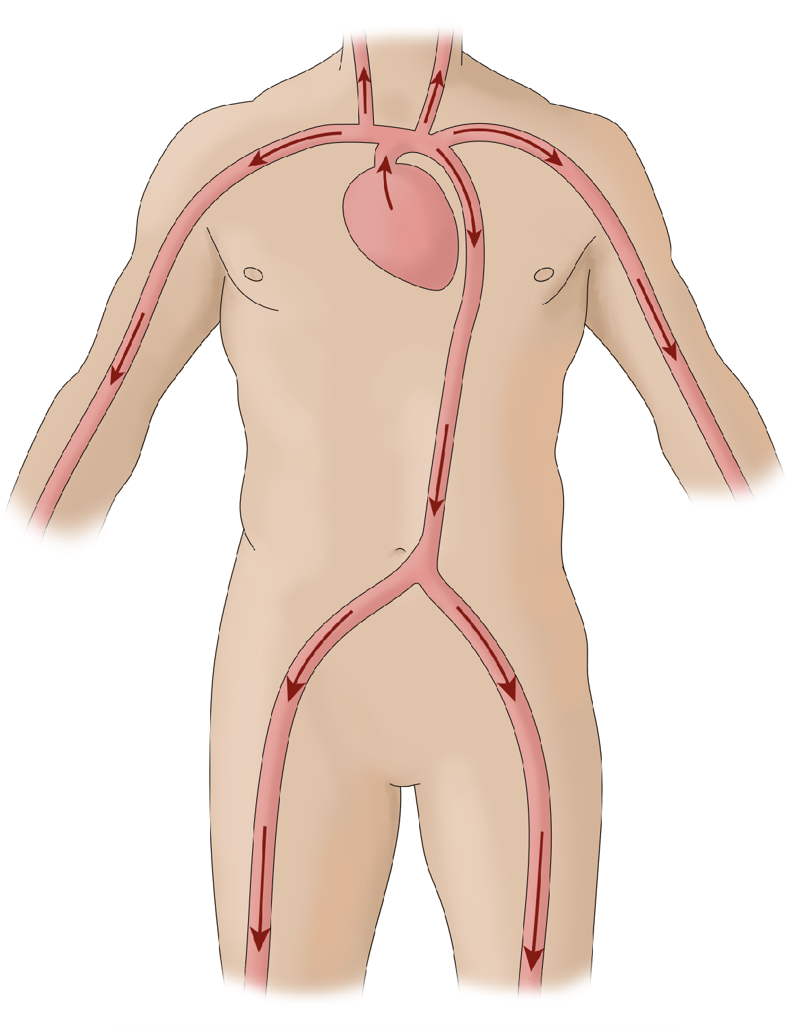
Bleeding Anatomy
©ACS
Notes:
Bleeding Anatomy
Key content elements
Clarify blood flowing and how bleeding results in loss of blood
Instructor considerations
Our bodies have an amazing system for delivering blood throughout our body. Think of it like a giant highway. The heart acts like a pump, pushing blood out to all our organs and tissues. This blood carries oxygen and nutrients that our cells need to function. Understanding how blood flows will help us control bleeding more effectively. By applying pressure in the right spot, we can slow down or even stop the blood flow to the wound.
Situational scenarios for presenting
Note the arrows directing blood from the heart, pumped to other parts of the body
Guiding discussion areas
Consider "blood flow anatomy" instead, but it works. The arrows help to set up the next slide.

Slide 12
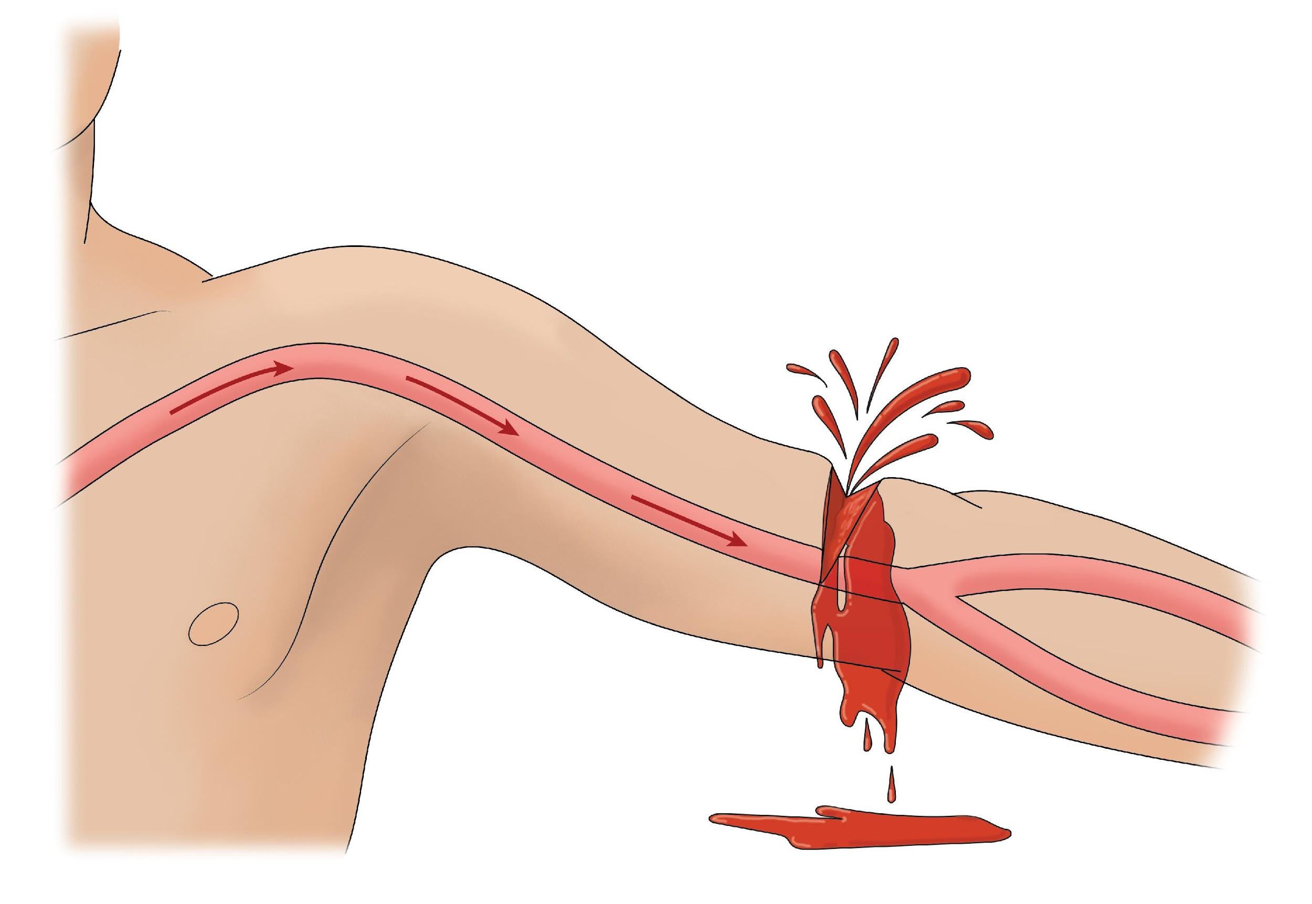
Uncontrolled Bleeding
©ACS
Notes:
Uncontrolled Bleeding
Key content elements
Recognizing bleeding
Instructor considerations
A sign of severe bleeding is a large pool of blood forming around the wound or on the ground around the victim. Also, be concerned if the person’s clothing is soaked with blood.The participant will learn how to identify severe bleeding. In a bad injury, blood might spurt out in pulses. This happens because the blood comes from a large artery, which carries blood with a lot of force from the heart. If you see either of these signs, acting quickly to control the bleeding is essential.
Situational scenarios for presenting
Uncontrolled bleeding can occur in many different scenarios, and recognizing these situations is crucial for immediate response and intervention.
Guiding discussion areas
Notice the blood flow demonstrated by arrows and how there are no arrows beyond the injury (i.e., no or limited blood flow)

Slide 13
Direct Pressure
©ACS
©ACS
Notes:
Direct Pressure
Key content elements
Demonstrate direct pressure as the first step
Instructor considerations
An effective step to control bleeding is called direct pressure. This means placing a cloth or towel directly, anything that is absorbent, over the wound and applying firm, steady pressure with your hand. The pressure helps to close off the blood vessels around the wound, slowing down or stopping the blood flow. The key is to push down hard and hold it there. Don't be afraid to press firmly – it might feel uncomfortable for the injured person, but stopping the bleeding is essential.
Once you begin holding pressure, you should maintain it until help arrives, or you need to use another bleeding control mechanism, such as wound packing or tourniquet application.
Do not lift the dressing to check; maintain steady pressure.
In emergencies where medical supplies are unavailable, several non-medical materials can help control bleeding.
Situational scenarios for presenting
Notice the rescuer is wearing a glove and has a small amount of material between the hand and the wound
Guiding discussion areas
Note that the blood vessel is compressed or flattened, reducing the loss of blood
What materials do you have now that can be used to stop bleeding?

Slide 14
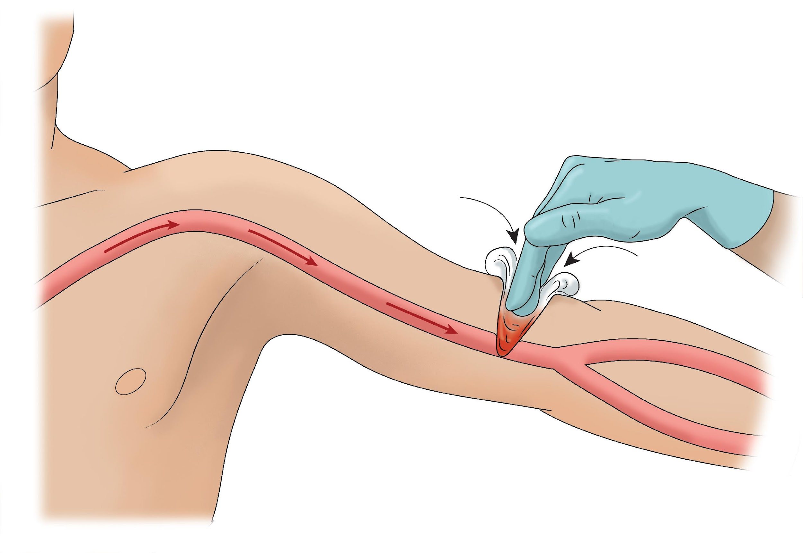
Wound Packing
©ACS
Notes:
Wound Packing
Key content elements
Demonstrate how to pack a wound if the direct pressure step does not stop bleeding
Instructor considerations
If direct pressure with a cloth isn't enough to stop the bleeding, there's another technique we can use called wound packing. This is important if direct pressure over the wound does not stop the bleeding. Wound packing involves gently stuffing gauze or some cloth directly into the wound. Packing the wound creates pressure from the inside, which can control the bleeding. This can be very effective for deep wounds or spurting blood. If gauze is not available, any available cloth can be used.​
Do not lift the dressing to check; maintain steady pressure.
Situational scenarios for presenting
Using some of that material or gauze from the STB kit to fill up the wound
If you do not have a bleeding control kit, several non-medical materials can help control bleeding.
Guiding discussion areas
What could be used as packing?
If you had to use something you are wearing now to pack a wound, what would it be?
Look around the room; what could be used to pack a wound?

Slide 15
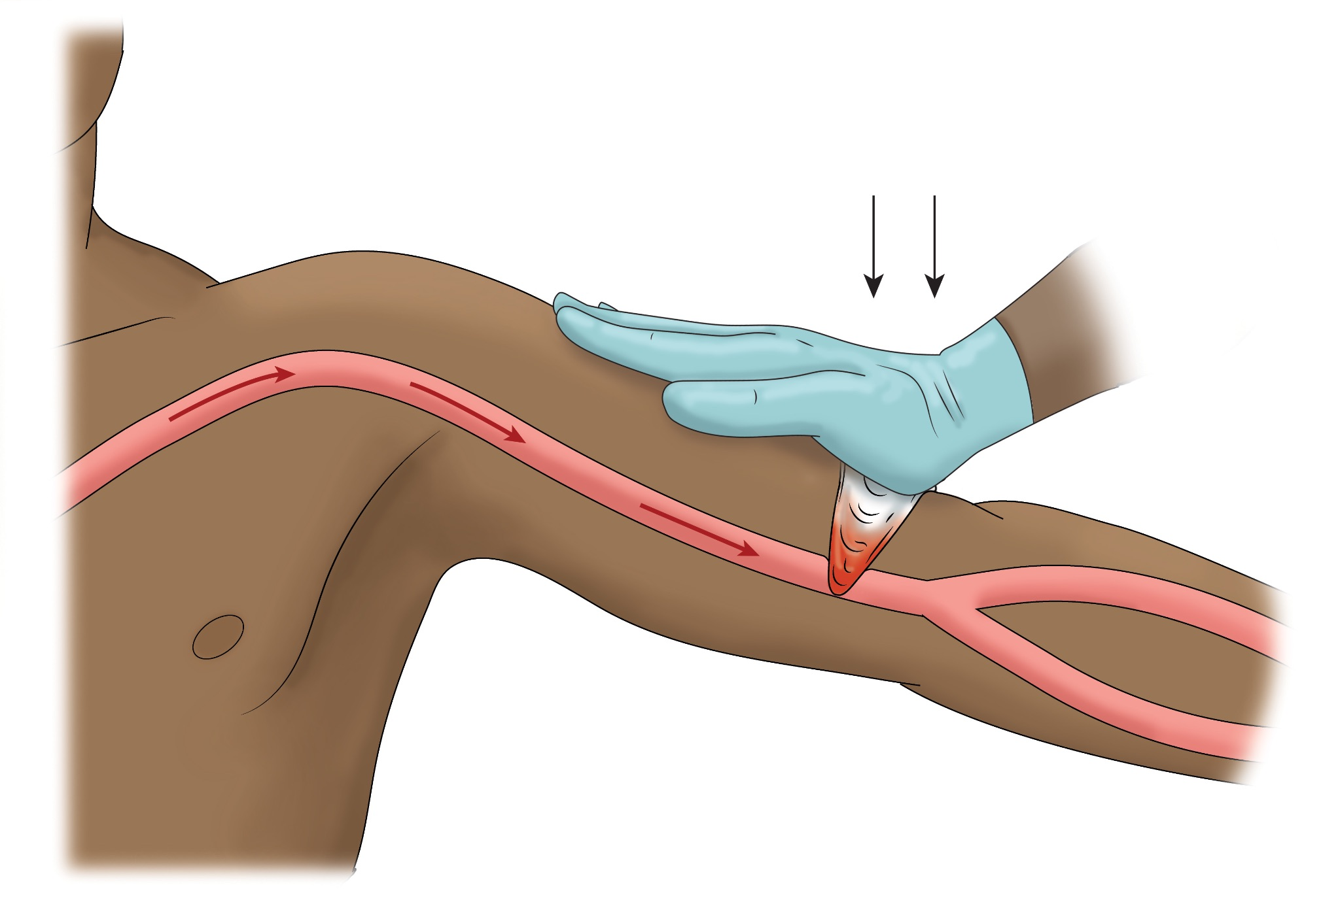
Apply Pressure After Packing
©ACS
Notes:
Apply Pressure after Packing
Key content elements
After packing the wound, direct pressure is re-applied and continued.
Instructor considerations
If a wound has been packed, you should still apply direct pressure over the packing. Place a clean cloth or towel over the gauze and press down firmly with your hand. This will help maintain the pressure on the wound and slow the bleeding. Your goal is to keep pressure on the wound until help arrives. Don't remove the packing – medical professionals will take care of that.
Situational scenarios for presenting
It is crucial not to REMOVE the packing to check the wound and maintain pressure until help arrives.
WHAT IF I AM BY MYSELF? WHAT DO I DO? (This is a frequently asked question.)
If you are alone and there is severe bleeding, you must act quickly to stop the bleeding. If you must leave to find help, ensure the wound is securely bandaged and pressure is maintained. If they are conscious and stable, instruct them to maintain pressure while you go. Look for other people nearby who may assist or help contact emergency services.
Guiding discussion areas
Respond to any questions or concern expressed by participants.

Slide 16
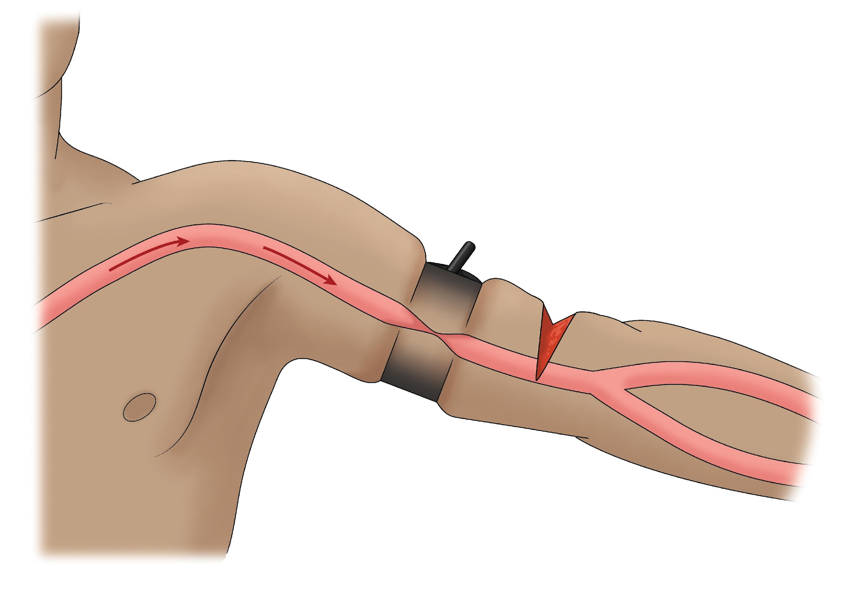
Tourniquet Application
©ACS
Notes:
Tourniquet Application
Key content elements
Last resort, application in severe injuries only
Instructor considerations
Tourniquets are a last resort for controlling bleeding. They are typically used in severe injuries to the arms or legs where direct pressure or wound packing isn't working. A tourniquet cuts off blood flow completely by squeezing the blood vessels shut. This can be very effective for stopping life-threatening bleeding, but using a tourniquet properly is critical. Using a tourniquet incorrectly can cause further damage to the limb or worsen the bleeding.
Situational scenarios for presenting
Imagine the tourniquet in orange, black, and red; notice no blood flow beyond TOURNIQUET above wound;
Guiding discussion areas
This slide has a black tourniquet, but the next page is orange— the instructor should be prepared to discuss the different colors and why the colors are important to understand.
The Combat Application Tourniquet (CAT) has three distinct colors that serve specific purposes, helping users apply it effectively during trauma care:
Black is used by military and law enforcement because the color is more subdued and blends seamlessly with their uniforms and camouflage patterns, allowing them to discreetly carry and deploy the medical device without drawing unnecessary attention in field operation.
Orange is used by the lay public because it is easily recognized by medical professionals, making it a clear and identifiable marker of care provided for a severe bleeding emergency.
Blue tourniquet indicates a training tourniquet and should not be used in a real-life situation.

Slide 17
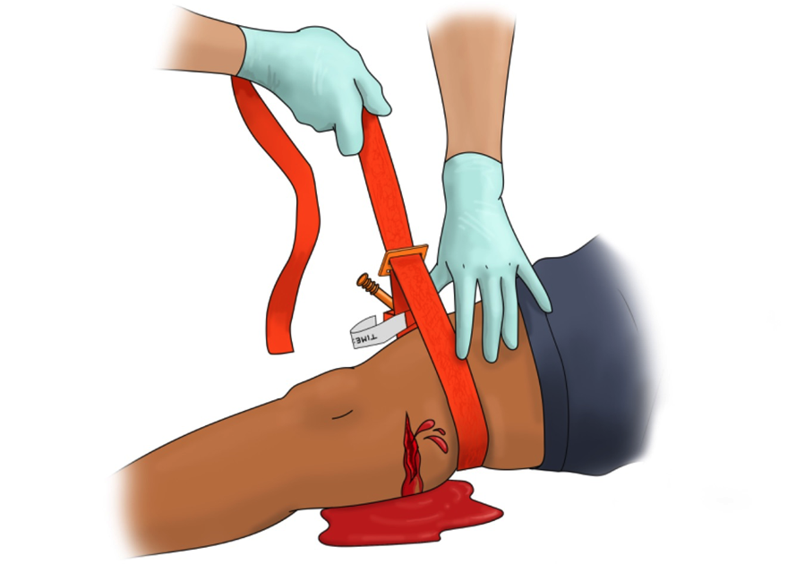
©ACS
Notes:
Tourniquet steps: wrapping the tourniquet
Key content elements
Applying the tourniquet;
Instructor considerations
In a severe bleeding emergency where direct pressure and wound packing aren't working, a tourniquet might be used as a last resort to stop life-threatening bleeding from an arm or leg. Here's an overview of proper placement, and you will be practicing this during the skills portion of the course.
Talk to the victim and reassure them you are helping them. Let them know what you are doing. Talk to them throughout the application. You can have someone assist with talking to the victim and use those around you to help.
Place the tourniquet 2-3 inches above the wound, avoiding joints (never place over a knee or elbow). If the wound is near a joint, place the tourniquet above the joint on the upper portion of the limb. Think back to what we learned about blood flow – by putting the tourniquet higher up, we can cut off the blood supply to the wound. The strap is then threaded through the buckle and tightened securely around the limb. Situational scenarios for presenting
DURING SKILLS, REMEMBER THAT THE INJURY IS ON AN EXTREMITY, AND YOU MUST PUT THE TOURNIQUET ON AS IF IT IS AN EXTREMITY.
Guiding discussion areas
N/A

Slide 18
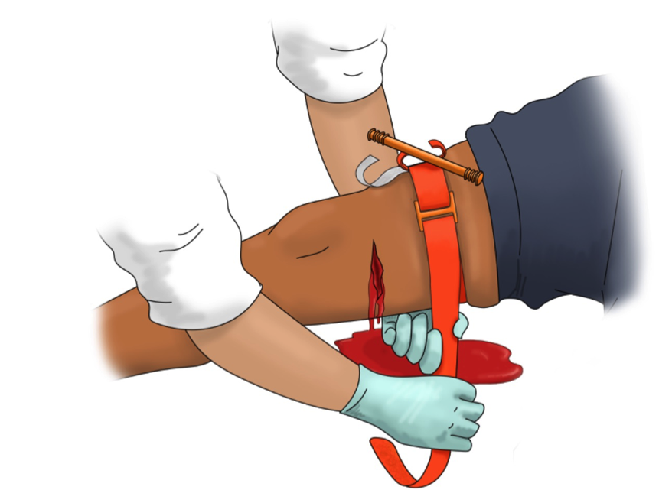
©ACS
Notes:
Tourniquet steps: pull tight
Key content elements
Understand that applying a tourniquet requires a TIGHT application
Instructor considerations
Continuing our overview of the tourniquet application, Route the self-adhering band around the limb and pass the free end through the buckle. Pull the band tight until it is snug around the limb. Secure the band back onto itself using the hook and loop fastener. Once the strap is threaded through the buckle, pull it tight around the limb. You should not be able to slip a finger between the strap and the skin. This ensures there is no slack in the tourniquet strap.
Use your free hand to pull the band, tightening it around the limb. Wrap the band around the limb and tighten it firmly; don't cover the windlass or clips. Fasten the band using the hook-and-loop fastener (Velcro).
Situational scenarios for presenting
Discuss different colors and styles of tourniquet.
Guiding discussion areas
These questions are intended to engage the participants and promote understanding and application of the key elements.
Do all tourniquets have "velcro" and does the term apply universally, or should we say 'hook and loop' closure? Or both?​

Slide 19
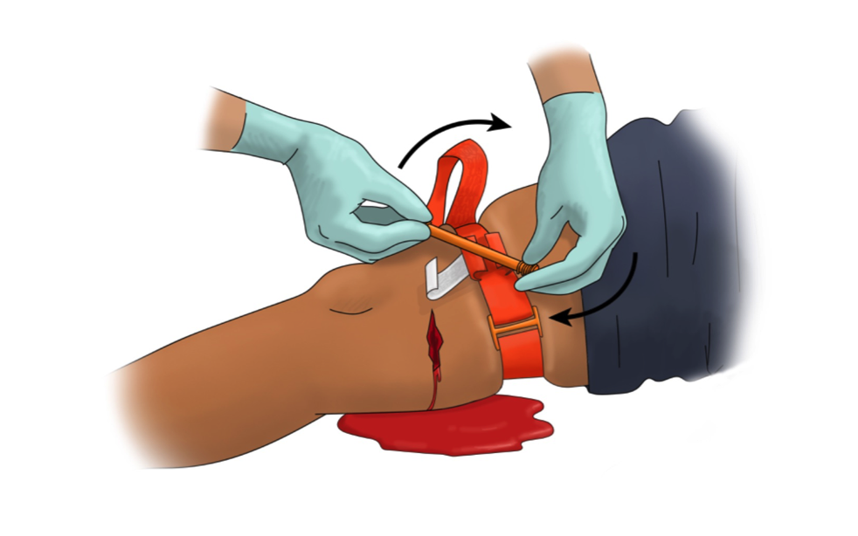
©ACS
Notes:
Tourniquet Steps: Windlass
Key content elements
Tightening the tourniquet causes pain
Instructor considerations
Once the strap is secure, locate the windlass rod on the tourniquet. This is the rod you'll twist to tighten the tourniquet further. Twist the windlass rod until the bleeding stops. The windlass can be turned in either direction. It's important to be aware that a properly applied tourniquet will cause significant pain to the injured person. Once the bleeding stops, secure the windlass rod in the clip to maintain pressure. Wrap the remaining strap over the windlass rod and secure it with the remaining strap. Place the white tab, that indicates time over the rod to ensure the tourniquet remains tight and in place.
Continue talking to the victim, reassuring them that help is coming.
Emergency Medical professionals can manage pain, if applicable​.
Never loosen or remove a tourniquet once it has been applied. This information is critical! Loosening the tourniquet could cause renewed bleeding, which can be very dangerous. Medical professionals will remove the tourniquet once they arrive on the scene.
Situational scenarios for presenting
Draw attention to the twisting and the buckle—they are ‘up’ and facing the rescuer
Guiding discussion areas
N/A

Slide 20
©ACS
Notes:
Completed Tourniquet
Key content elements
Remember to discuss marking time, and NEVER remove a tourniquet
Instructor considerations
Once you've tightened the tourniquet and secured the windlass rod, write the time of application on the tourniquet. If you do not have a pen or marker, note when you put the tourniquet on the victim and let emergency responders know when they arrive. This is essential information for medical professionals, as it helps them determine how long the limb has been deprived of blood flow. If you don't have a pen, don't worry! Make a mental note of the time and tell the medical professionals when they arrive exactly when you applied the tourniquet.
Situational scenarios for presenting
The victim may experience severe pain and scream and tell and ask the rescuer to remove the tourniquet due to pain; it’s very important to remain calm and help them stay calm.
Guiding discussion areas
If you need to apply another tourniquet because bleeding hasn’t stopped, what should you do?

Slide 21
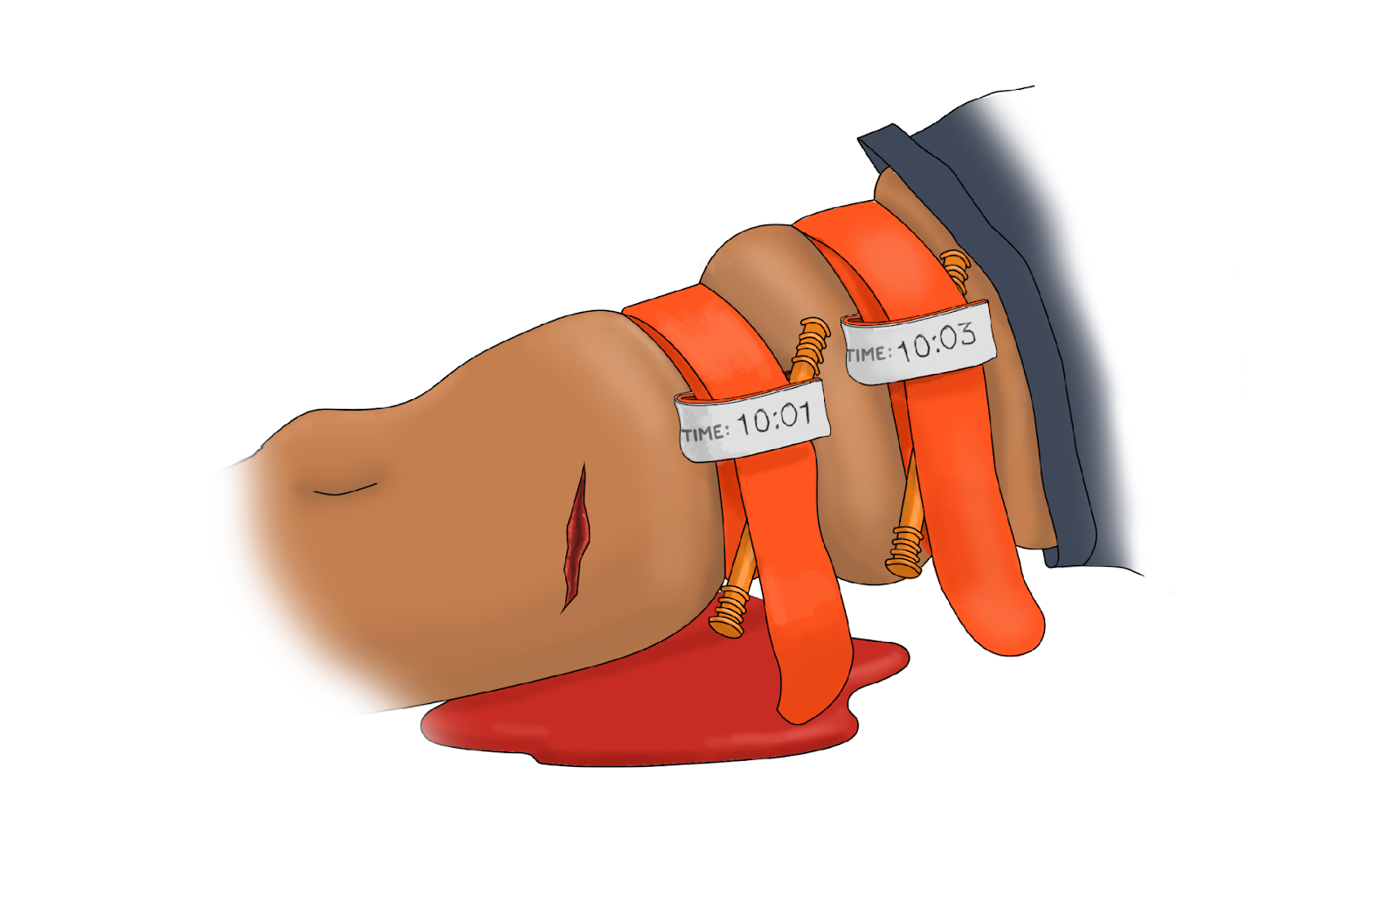
©ACS
Notes:
Key content elements
Address if the first tourniquet does not stop bleeding; another can be applied above the initial tourniquet.
Apply the second tourniquet in the same manner as the first one.
Instructor considerations
The first tourniquet does not fully stop bleeding (continued bright red or spurting blood).
The first tourniquet cannot be tightened any further, and bleeding persists.
The injury is on a large limb, such as the thigh, where one tourniquet may not generate enough pressure.
Situational scenarios for presenting
Recognizing when one tourniquet is not enough and the need for a second.
Proper placement and spacing of the second tourniquet.
The importance of reassessment to confirm bleeding control.
Effective communication with EMS, ensuring timely and accurate patient care.
Guiding discussion areas
How do you determine that a second tourniquet is needed?
What are the signs that the first tourniquet is insufficient (e.g., continued bleeding, inadequate pressure)?
Where should the second tourniquet be placed in relation to the first?
What considerations should be taken to avoid placing the tourniquet over joints, wounds, or prosthetics?

Slide 22
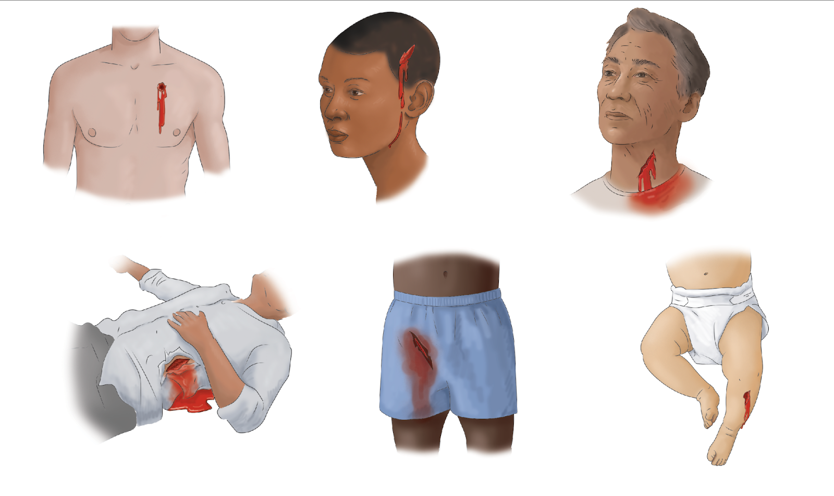
Frequently Asked Questions
©ACS
©ACS
©ACS
©ACS
©ACS
©ACS
©ACS
Notes:
FAQ
Key content elements
Address frequent questions and ask for more, empowering rescuers at the start and end of the program.
WE NEED TO LIST FAQ’S WITH RESPONSES
Instructor considerations
We've learned that tourniquets are important for severe bleeding in the arms and legs. However, they are not appropriate for all wounds. This slide shows some examples, like chest wounds, abdominal wounds, groin wounds, scalp wounds, neck wounds and even injuries to infants. You won’t be able to use a tourniquet effectively for these types of injuries. The best course of action is to apply direct pressure with a clean cloth or towel and hold pressure until help arrives. By applying firm and steady pressure, you can make a big difference. It is important to speak to the victim and let them know that professional help is on the way.
IF THE PARTICIPANT HAS ADDITIONAL QUESTIONS, ONLY ANSWER THOSE YOU ARE COMFORTABLE WITH ANSWERING. IF YOU CANNOT ANSWER THE QUESTION, SEND THE QUESTION TO ACS STAFF, AND THEY WILL PROVIDE AN ANSWER. Send questions to stopthebleed@facs.org.
Situational scenarios for presenting
Chest, head/scalp, neck, trunk/torso, groin, children
Guiding discussion areas
Does anyone have additional questions that have not been answered?

Slide 23
Summary
©ACS
©ACS
©ACS
©ACS
©ACS
©ACS
Notes:
Disclaimer
Key content elements
Key points—tourniquet applications vary; improvised devices are important to discuss, and removal/conversion should only be removed by trained surgeons.
Instructor considerations
Do your research regarding tourniquets in your local areas. What is being used? Where they can be found. If there are guidelines or legislation, this would be a good time to speak to the legislation, specifically if you are training identified individuals impacted by the legislation, i.e., Texas schools, Colorado schools, and California building requirements.​
Review Good Samaritan Acts as they differ globally. Be prepared to speak to the specific laws
The ACS does not advocate using improvised tourniquets as the efficacy is not guaranteed. Commercial-grade tourniquets should be used. Remember that you have learned two other processes during the course, direct pressure and wound packing, that will help stop bleeding. ​
As discussed in the course, you should never remove a tourniquet; only trained medical professionals should do so. Reiterate not to remove a tourniquet.
Situational scenarios for presenting
N/A
Guiding discussion areas
What types of tourniquets are being used in your area?
Do you have bleeding control equipment accessible in your community?

Slide 24
Summary
©ACS
©ACS
©ACS
Notes:
Disclaimer
Key content elements
Key points—critical techniques for bleeding control include the application of pressure, packing of wounds and tourniquet application
Instructor considerations
Do your research regarding tourniquets in your local areas. What is being used? Where can they be found? Remember the ACS COT as a source for tourniquets
If there are local guidelines or legislation, this would be a good time to speak to this, especially if you are training individuals impacted by the legislation, i.e., Texas schools, Colorado schools, and California building requirements.​
Review Good Samaritan Acts as they differ globally. Be prepared to speak to local laws.
The ACS does not advocate using improvised tourniquets as efficacy is not guaranteed. Commercial-grade tourniquets should be used. Remember that you have learned two other processes during the course, direct pressure and wound packing, that will help stop bleeding. ​
As discussed in the course, you should never remove a tourniquet; only trained medical professionals should do so. Reiterate not to remove a tourniquet.
Situational scenarios for presenting
N/A
Guiding discussion areas
WHAT TYPES OF TOURNIQUETS ARE BEING USED IN YOUR AREA?

Slide 25
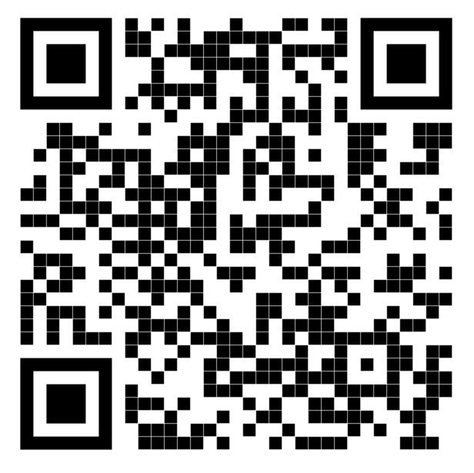

For more information: StoptheBleed.org
ACS Stop the Bleed Equipment
ACS Stop the Bleed Interactive Course
Notes:
For more information
Key content elements
Participant learning objective
Instructor considerations
This program's goals were to recognize life-threatening bleeding and take the appropriate steps to control bleeding until help arrives.​
With this training, you can save lives.​
The QR codes allow participants to go to the shop page of the ACS Stop the Bleed website to purchase kits and direct the participant to the ACS Stop the Bleed Interactive Course. The instructor should speak to the sales of all kits supporting the ACS Stop the Bleed Program to fund research, updated program requirements, and new course materials.
Additionally, the participant can visit the webpage for information.
Situational scenarios for presenting
N/A
Guiding discussion areas
RECRUIT INSTRUCTORS

Slide 26
The only thing more tragic than a death is a death that could have been prevented.
Content and Illustrations © American College of Surgeons (ACS). All rights reserved. Material cannot be used, reproduced, distributed, or displayed without the express written permission of the ACS.
STOP THE BLEED® is a registered trademark of the U.S. Department of Defense, Defense Health Agency. All rights reserved. © DoD.
The American College of Surgeons’ Stop the Bleed program is operated pursuant to a licensing agreement granted it by the Department of Defense
Notes:
The only thing more tragic
Key content elements
Participants can utilize the QR code to access the ACS Stop the Bleed Interactive Course to reinforce their knowledge of bleeding control techniques.
Instructor considerations
Remind the participant, through the interactive course they can review the necessary steps to control bleeding and be encouraged to promote the course to others, fostering broader awareness and competency in bleeding control.
Situational scenarios for presenting
N/A
Guiding discussion areas
Encourage the participant to promote the ACS Stop the Bleed Program and encourage others to take the course.

